Slide 1
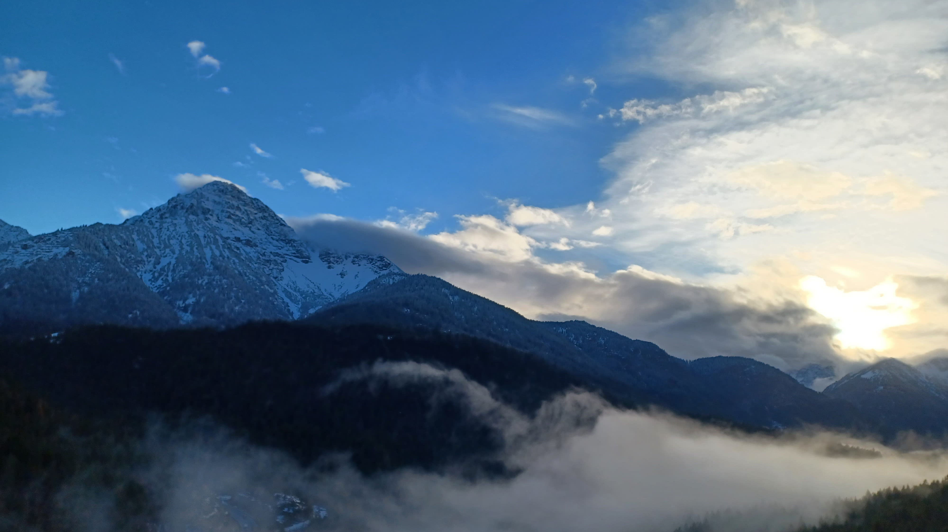
Erasmus
In
isny
Valerio Riccio
Ginevra Papi
Giorgia Rita
Martina Vichi

Slide 2
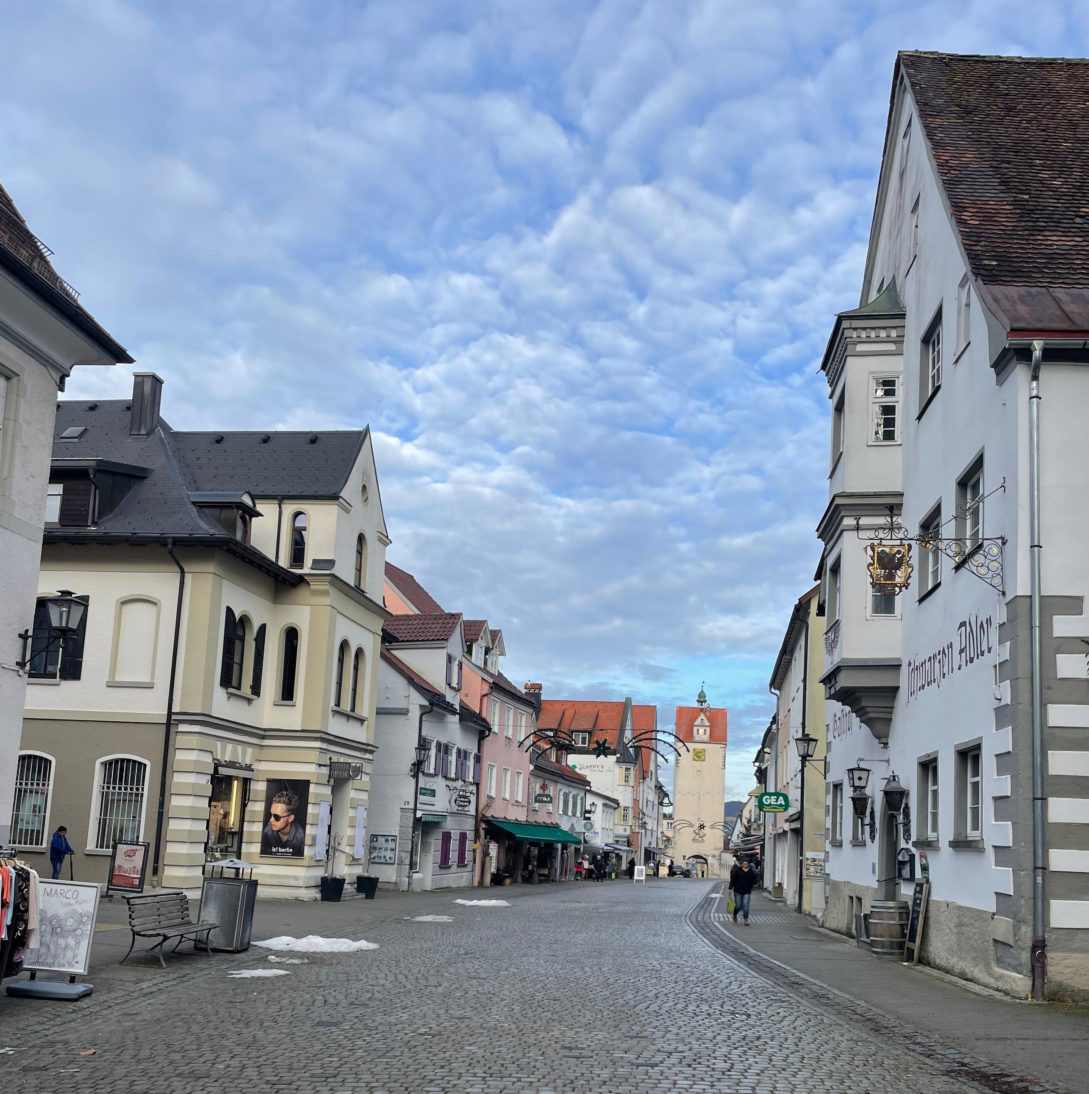
Day 1 – 1st December
We left Rome at 7:20 AM from Roma Termini, embarking on a long 11-hour journey. We changed trains three times, stopping in Milan, Zurich, and finally Lindau, where we met the German teacher. From there, we were taken to a restaurant where we received a warm welcome. For dinner, we enjoyed some typical dishes such as schnitzel (potatoes and meat), kartoffelsalat (potato salad), and spätzle with cheese.
After dinner, we went to our respective host families' homes.

Slide 3
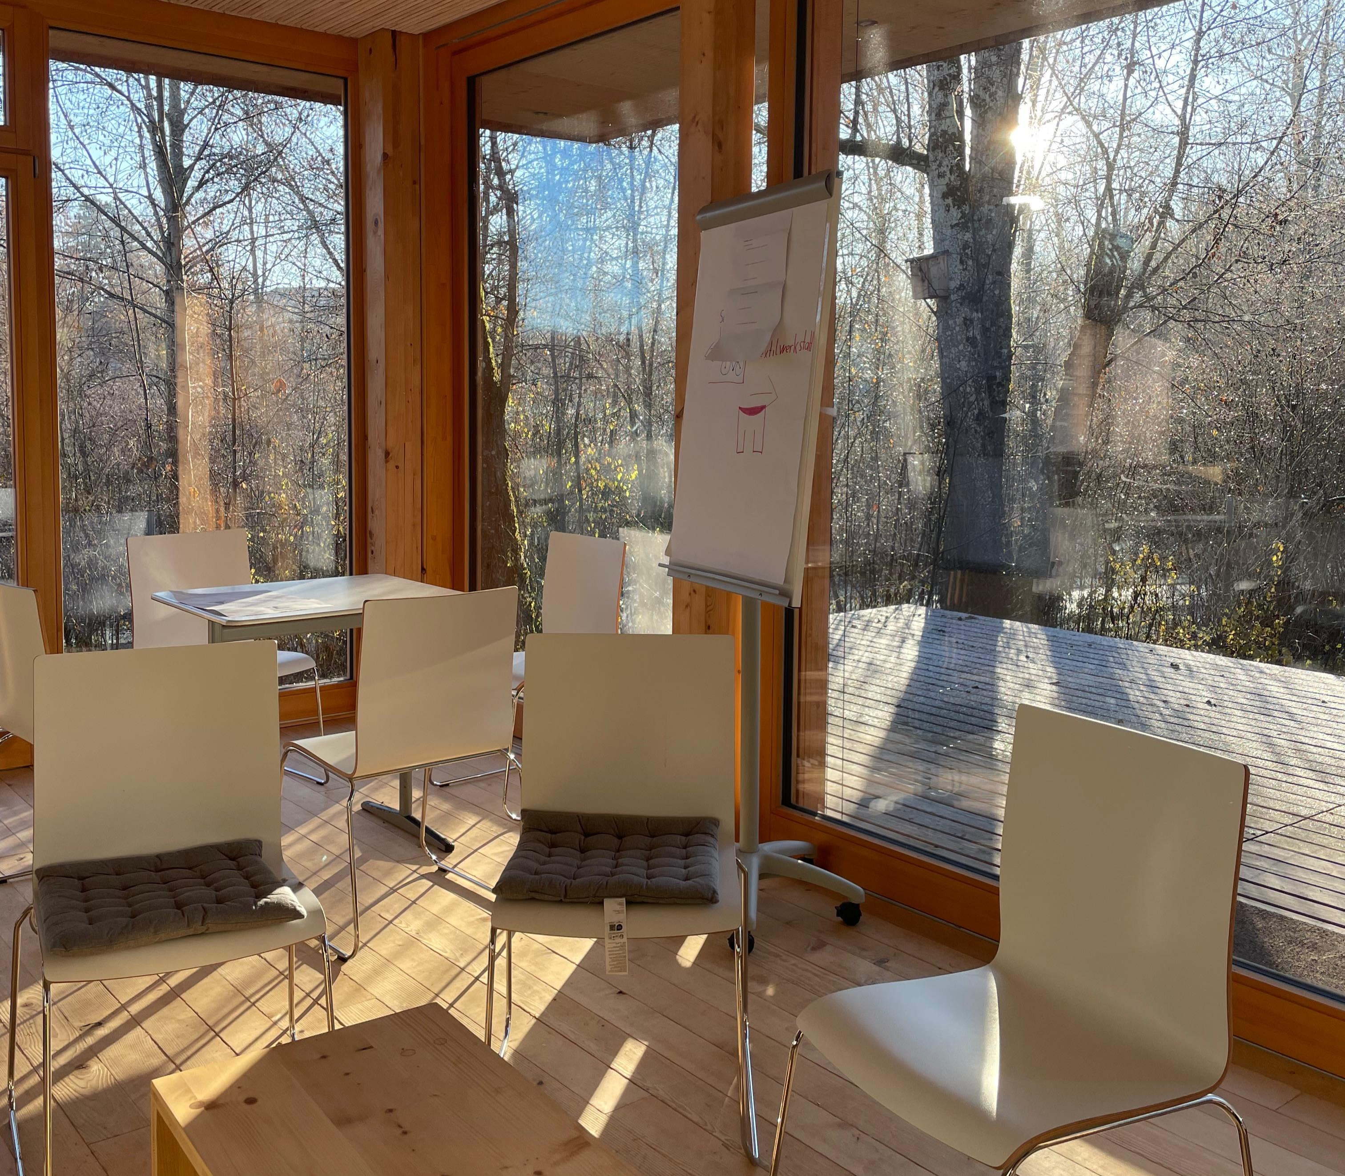
Day 2 – 2nd December
It was our first day of school, and at 7:30 AM, we attended two hours of lessons with German students. Afterwards, we visited a special house built by students, which was completely sustainable and self-sufficient. The house included a small kitchen, a bathroom, and a spacious area where we sat and talked during our visit.
We noticed many differences between Italian and German schools: in Germany, high school, middle school, and elementary students share the same building, and they all have lunch together. At the entrance, there’s a large hall where students can study and eat, and it’s also common for them to have classes in the afternoon.
We had lunch at the school cafeteria and later visited Isny.

Slide 4
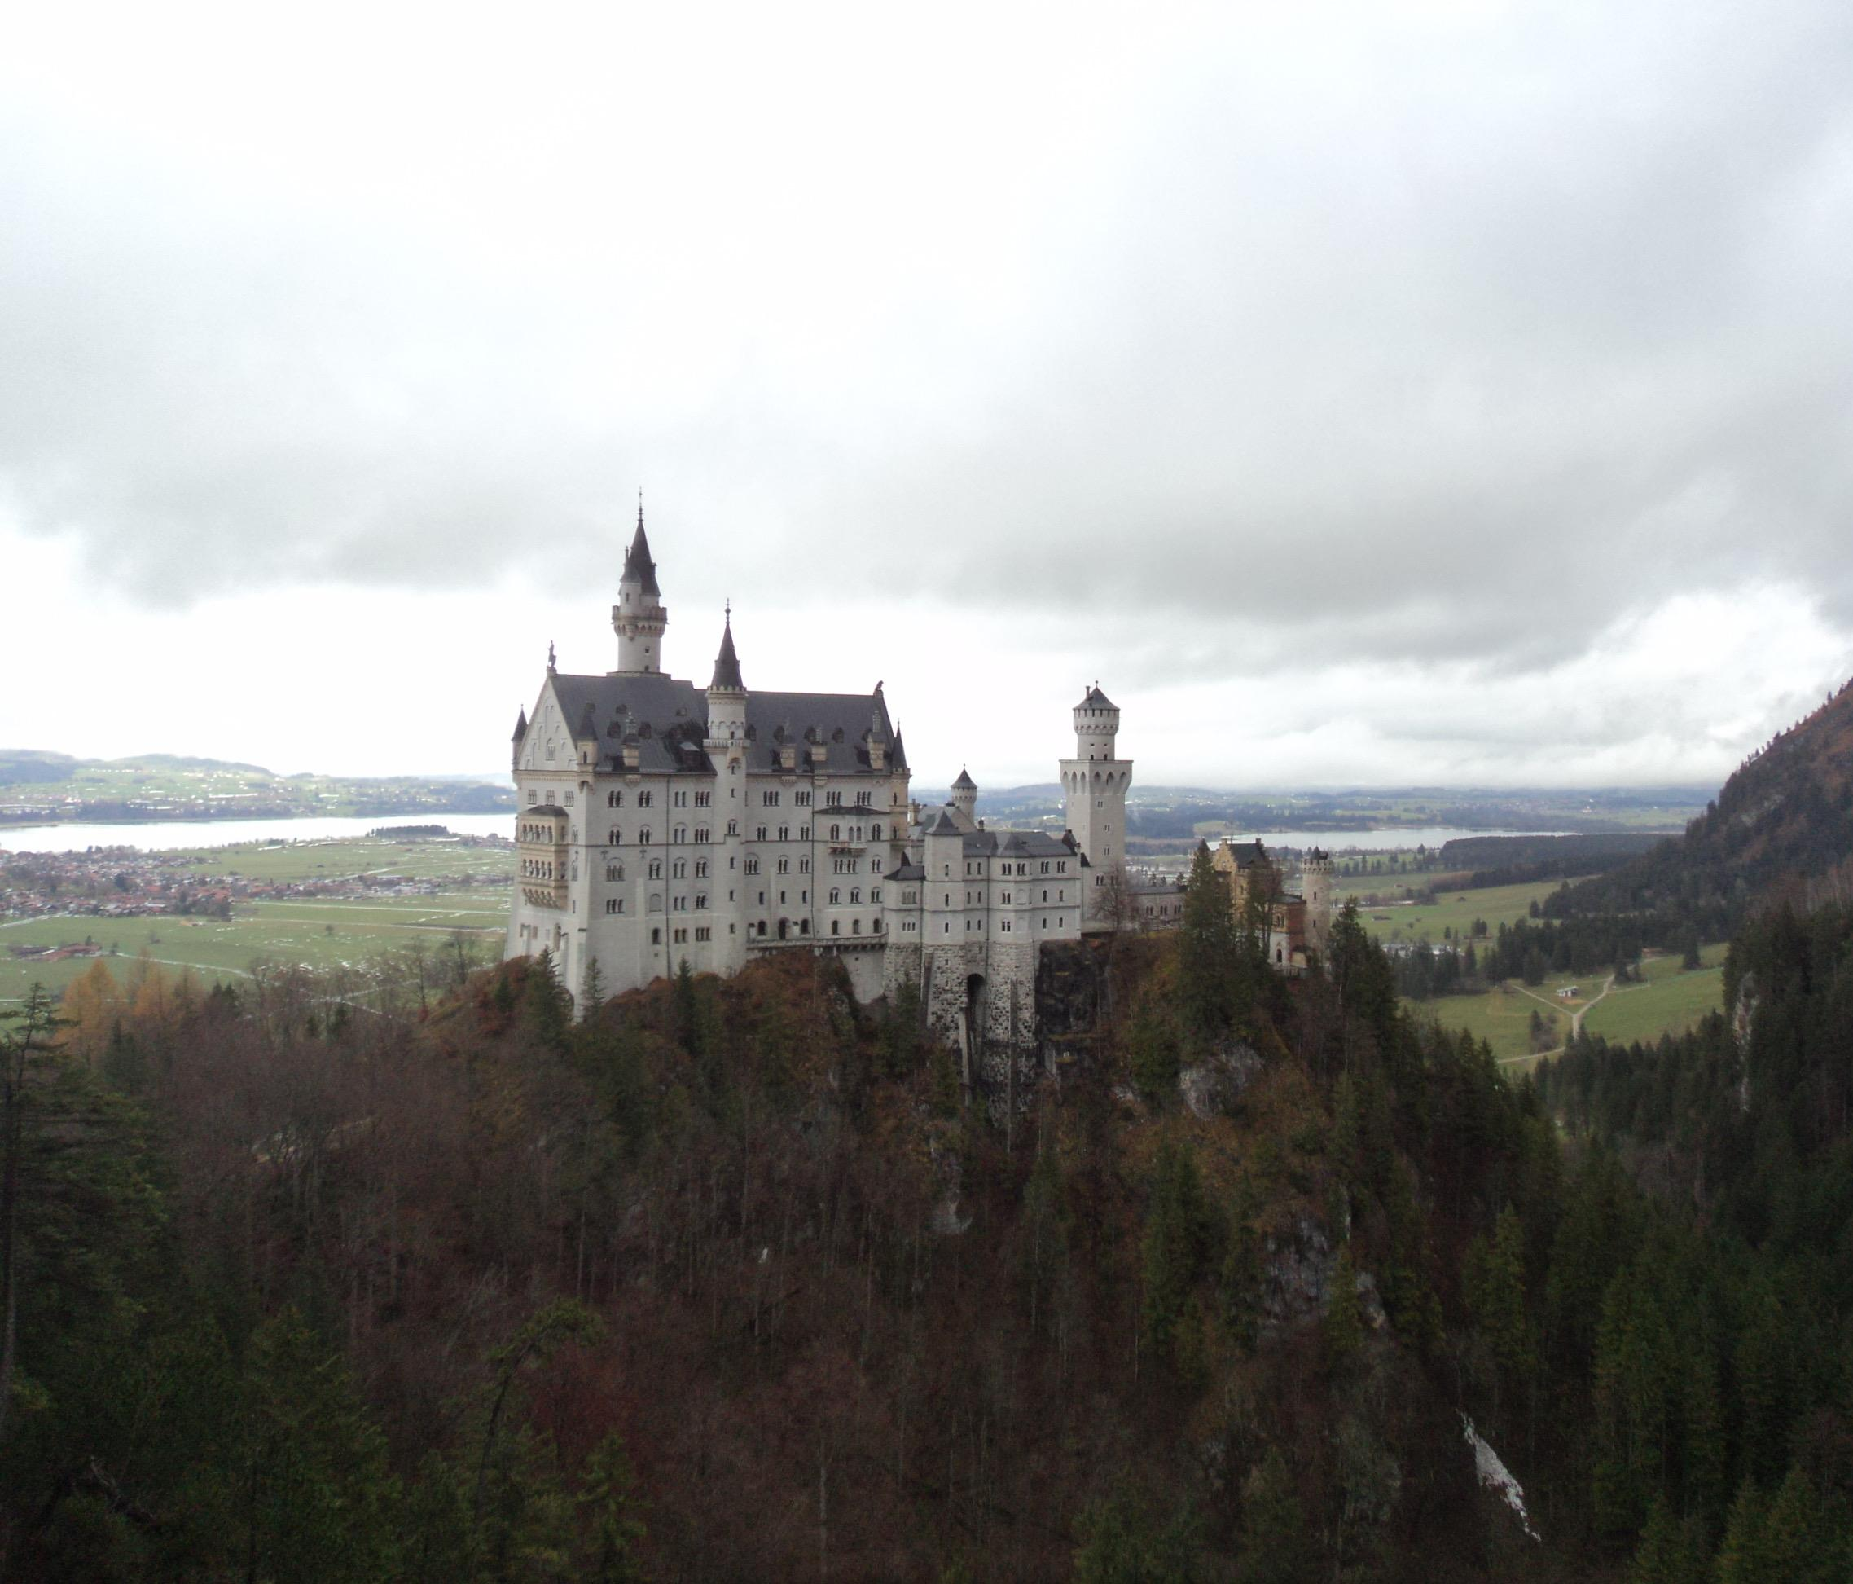
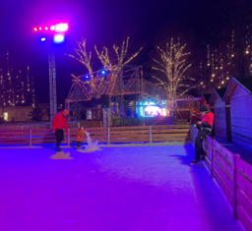
Day 3 – 3rd December
This was the busiest day of the trip. In the morning, we took a bus to Füssen and Reutte. After a long walk through the woods in the rain, we reached the bridge offering a view of Neuschwanstein Castle, built by Ludwig II of Bavaria, who constructed many castles in the region.
Next, we visited the suspension bridge “Highline 179.” It was incredibly high, but the breathtaking view, especially with the sunlight, felt like something out of Dante’s Paradise.
Later, we went ice skating. Some of us learned and had fun, while others didn’t enjoy it and opted to drink Glühwein (hot wine) instead.

Slide 5
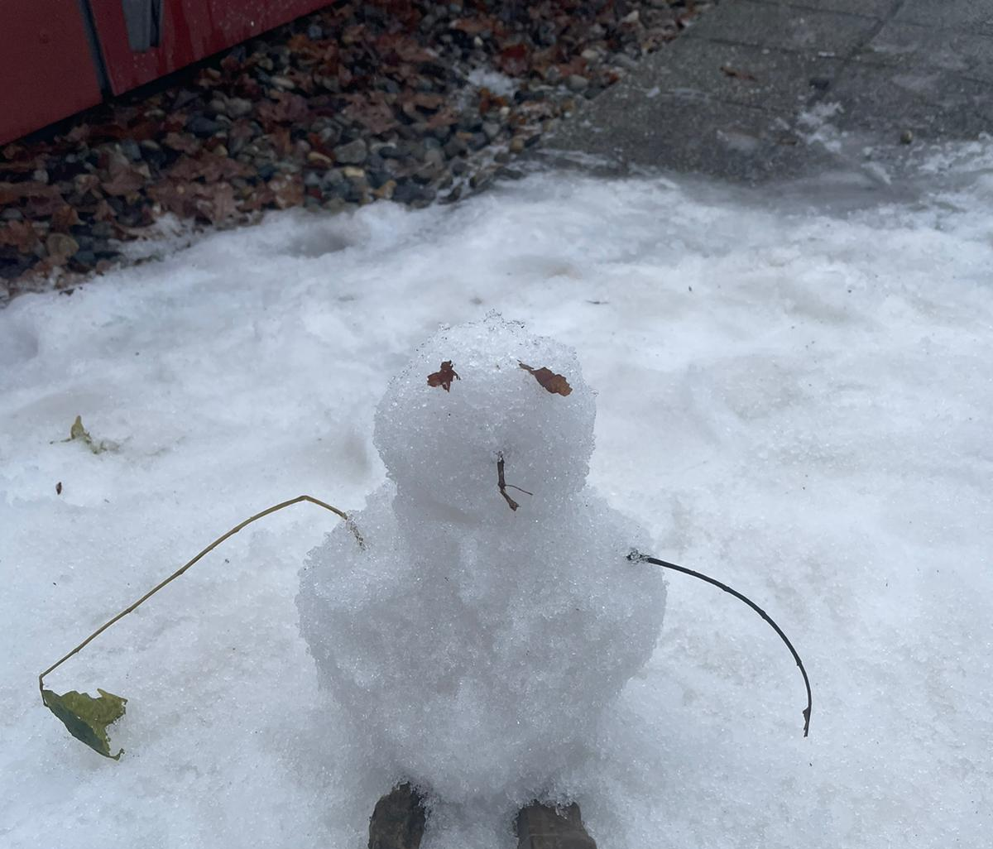
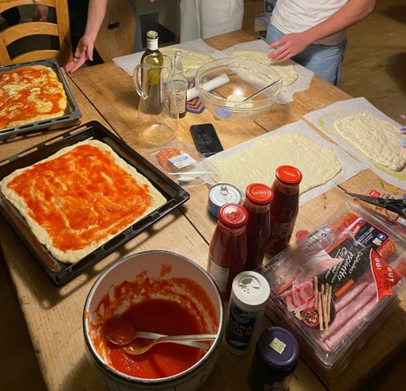
Day 4 – 4th December
In the morning, we attended two hours of lessons—Chemistry and English. One thing that impressed us was that each subject had its own dedicated laboratory, and lessons were held there. During the break, it snowed, so we built a small snowman and had a snowball fight.
In the afternoon, we went to a swimming pool, which was both beautiful and relaxing. It was large, with additional outdoor pools filled with hot water surrounded by snow—a stunning sight. We also experienced some adrenaline by jumping from a five-meter platform.
In the evening, we went to a German boy’s house and made pizza together.

Slide 6
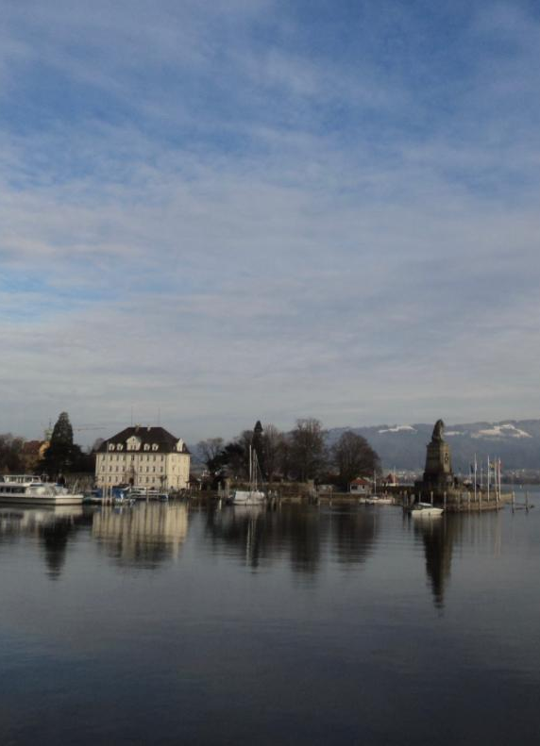
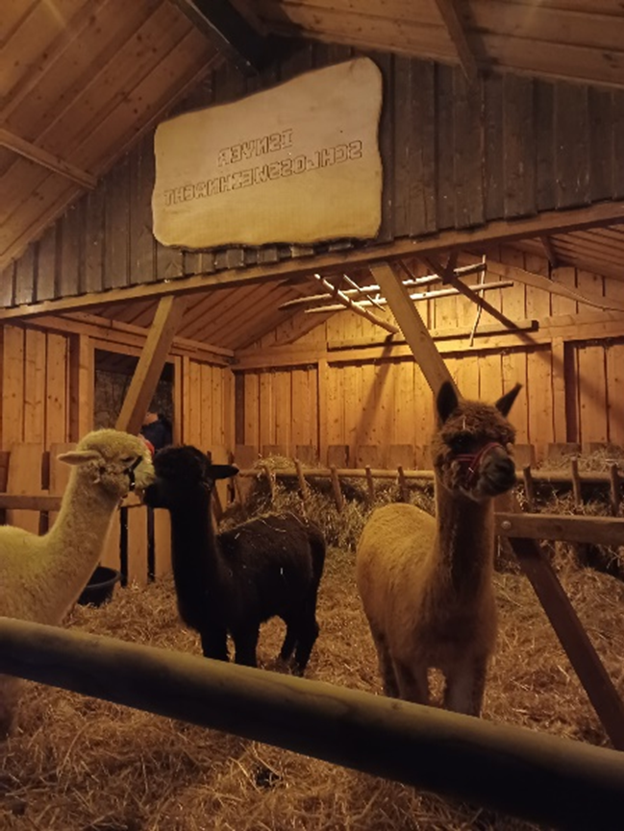
Day 5 – 5th December
On Thursday morning, we went to school and then visited Lake Constance. There were many stalls where we bought souvenirs. In the evening, we went to the Isny Christmas market. At the entrance, we saw llamas, and we waited until 6:30 PM for a special German tradition: an angel descends from a window using a pulley and reaches the ground.
We had dinner at the market with typical food and drank Kinderpunsch, a sweet, non-alcoholic hot beverage.

Slide 7
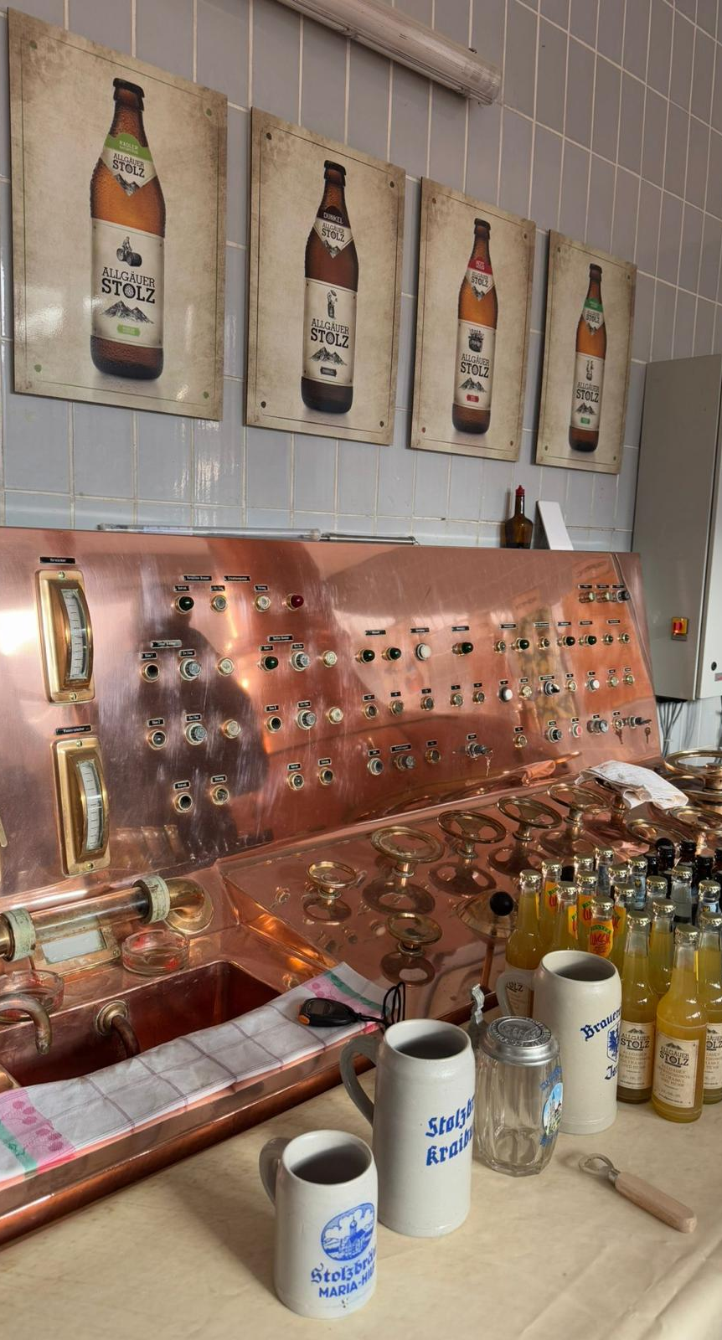
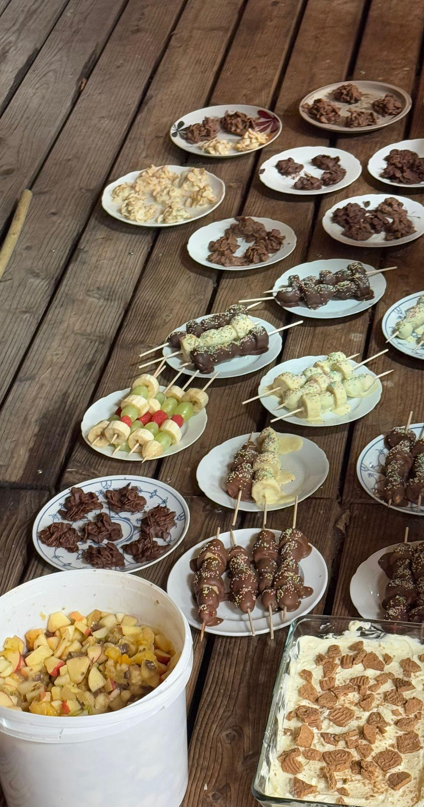
Day 6 – 6th December
In the morning, we visited a facility that produces energy for the city using wood waste. We also toured a brewery, where they explained the beer-making process and gave us a bottle to taste.
In the afternoon, we went shopping for supplies for the farewell party we had that evening. Back at school, we split into groups to prepare: some decorated for Christmas, others handled music, and the rest organized the food. For dinner, we prepared vegan salad, tacos with guacamole, spekulatius, ginger biscuits, and fruit dipped in chocolate and sprinkled with colorful sugar.
We lit a fire and cooked würstel wrapped in homemade bread around it.

Slide 8
Day 7 – 7th December
At 9:00 AM, we said goodbye to our host families and took the trains back to Rome. Once we arrived, our Erasmus experience came to an end.

