Slide 1
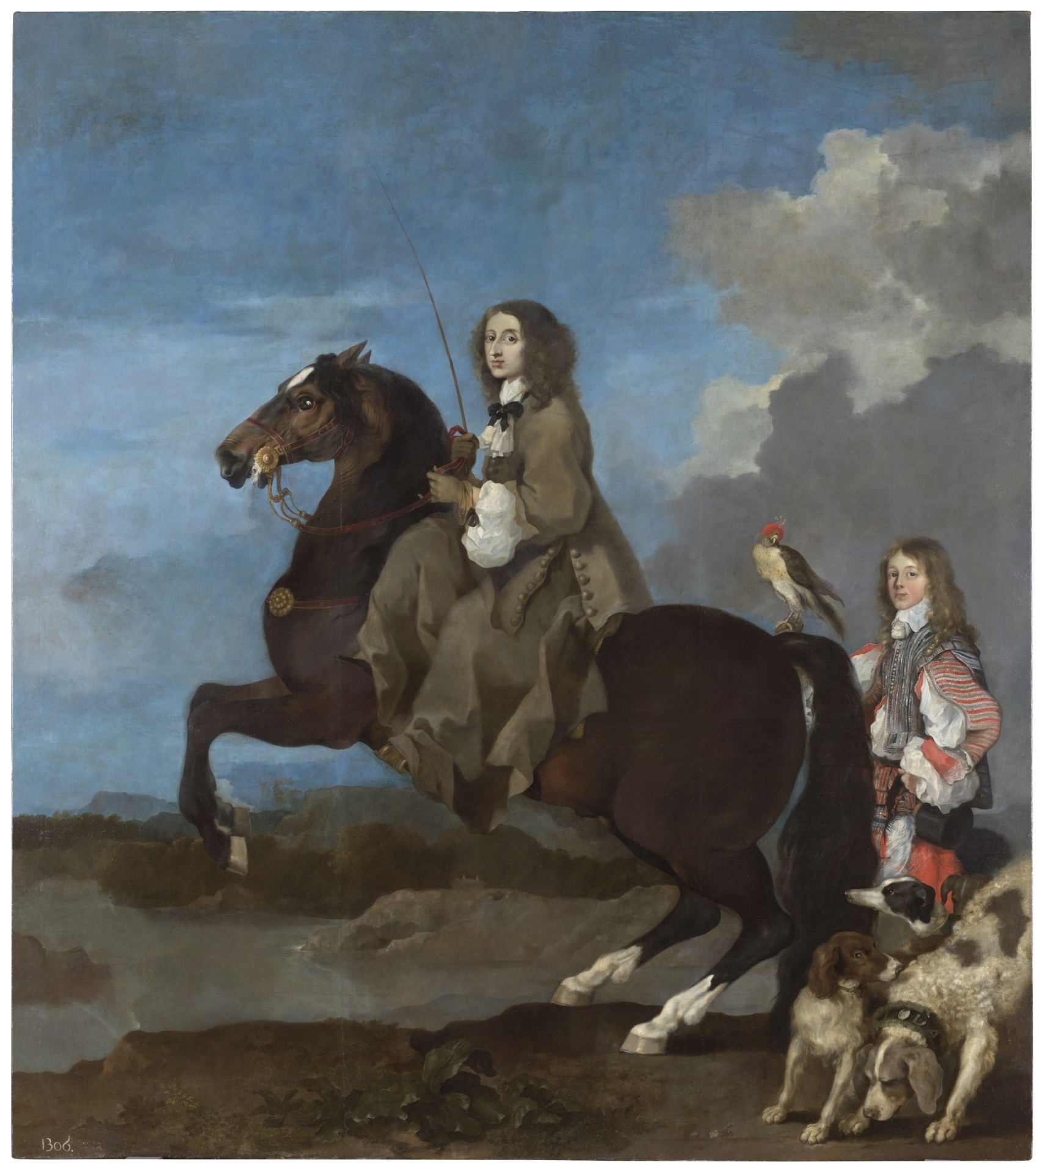
KRISTINA
The Northern princess who shaped Rome forever
1626 - 1689

Slide 2
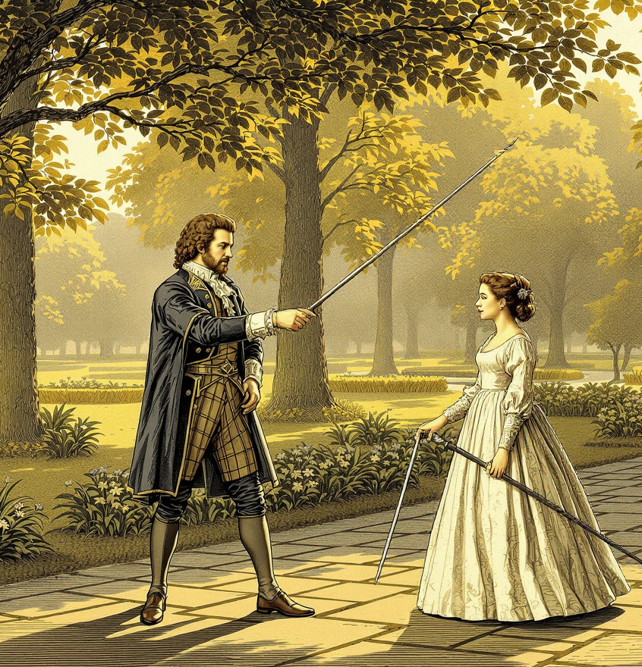
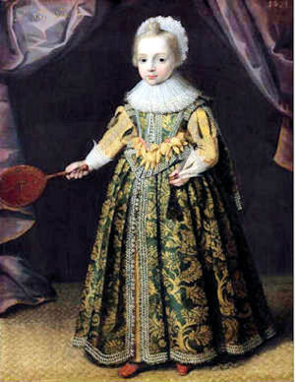
Childhood
«I was born all covered in body hair, from my head to my knees. So everyone thought I was a boy and the palace was flooded with joy…»

Slide 3
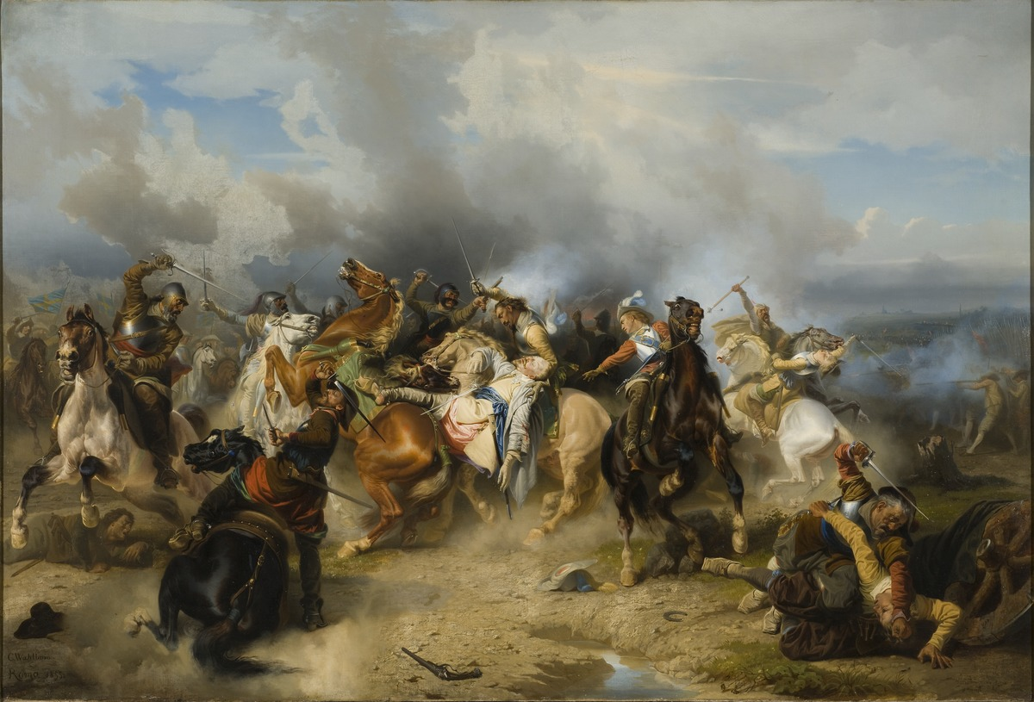
Death of the father
Lützen, 1632

Slide 4
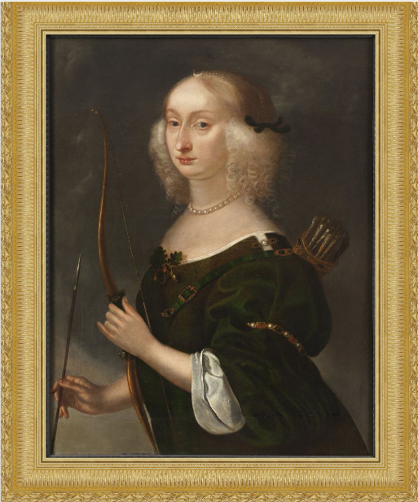
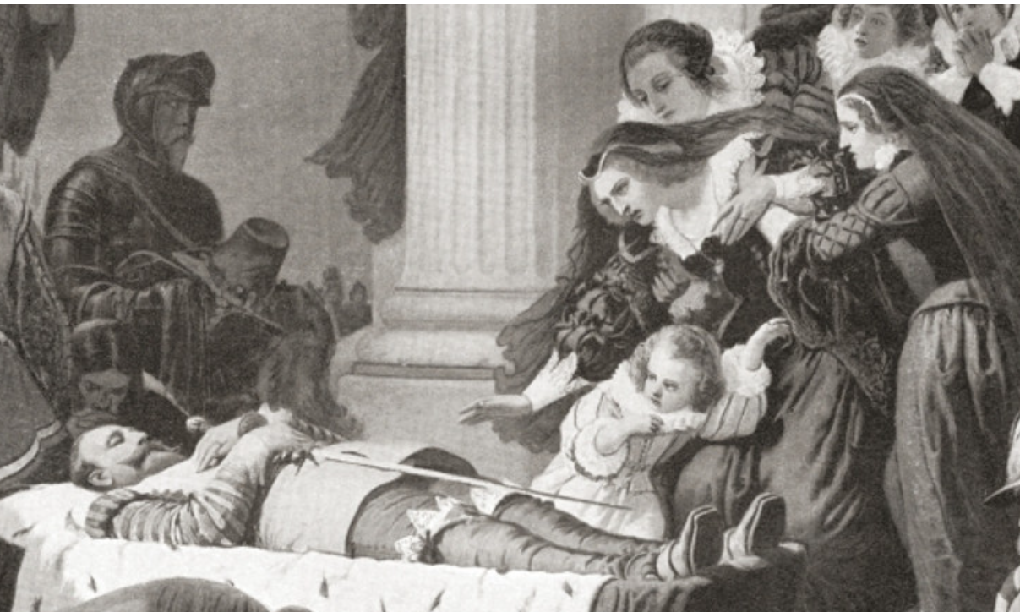
Madness of the mother
After two years of grief, Eleanor of Brandenburg was forcibly separated from her daughter

Slide 5
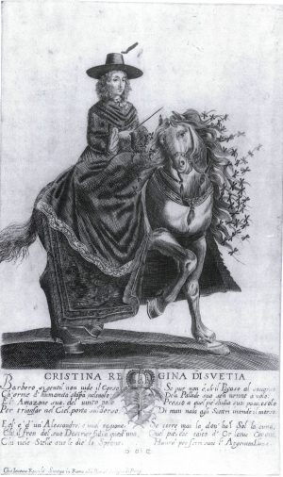
Not a standard lady
«Patience is the virtue of those who lacks either courage or strenght».
«Despair is pride: a secret and criminal presumption».
«Weakness is the greatest of misfortunes and the greatest of defects».
«Not only money, but also health, exists to be spent».
«We are always children: we just change our games and our toys».

Slide 6
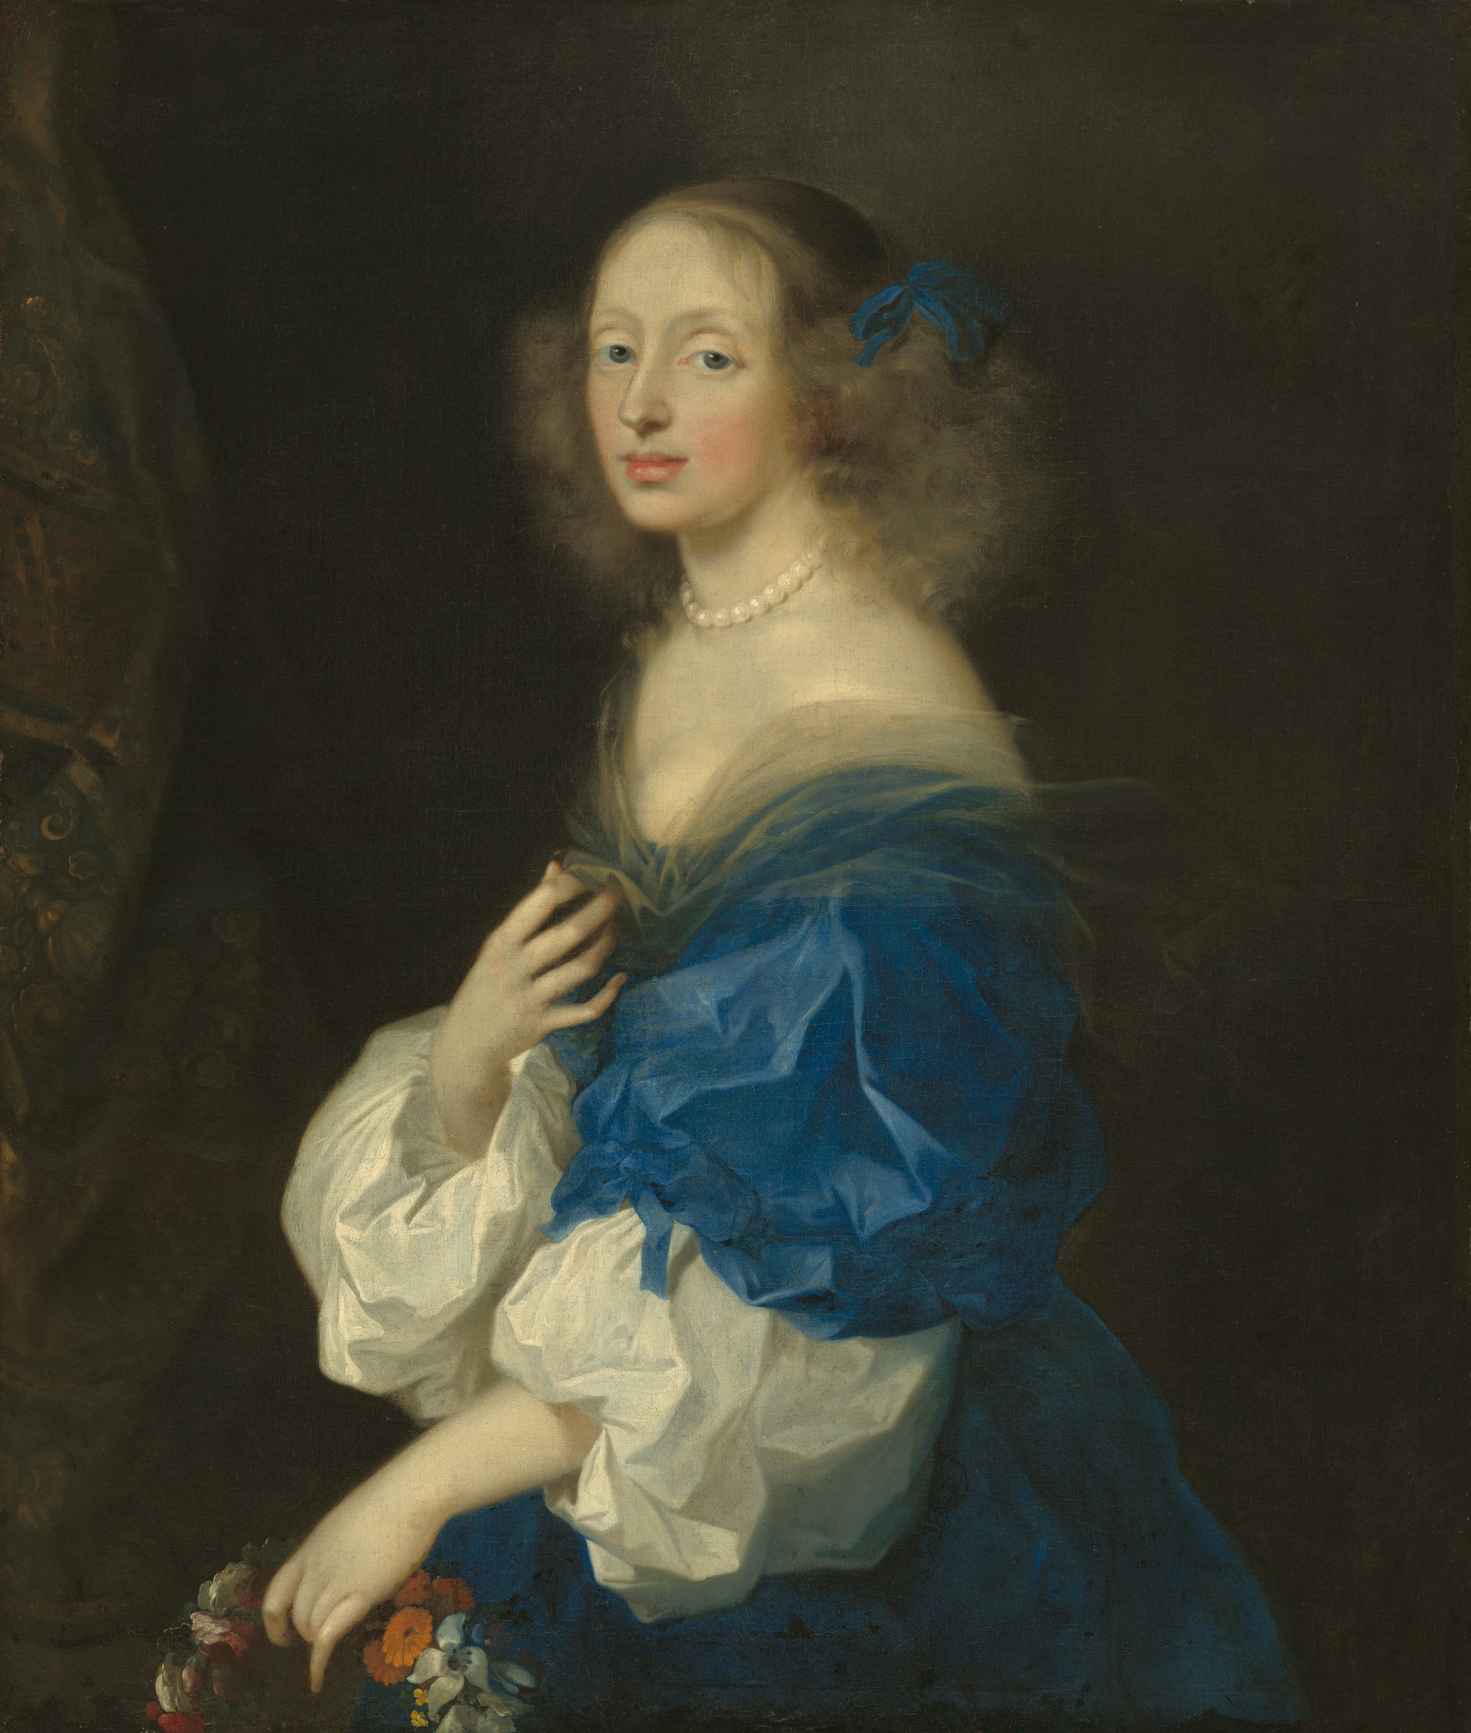
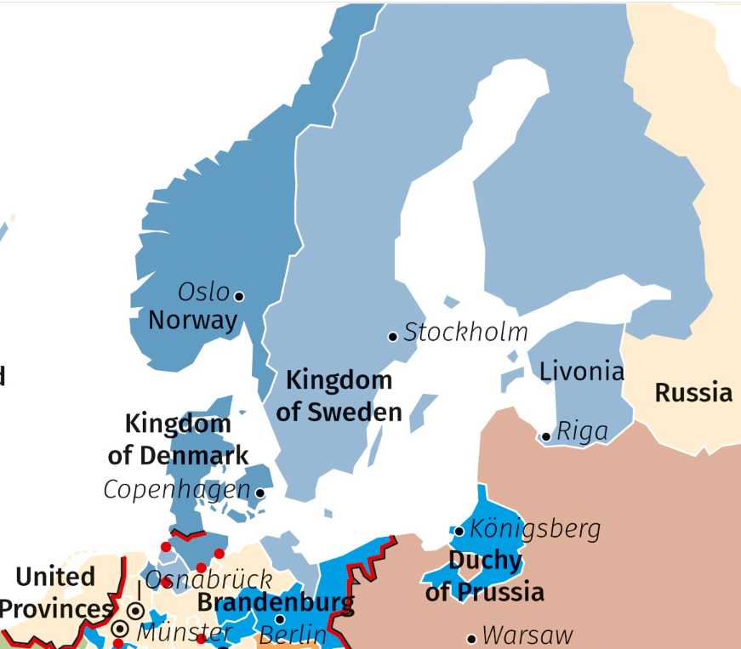
A brilliant start
1644 – 1648: Kristina settled brilliantly the Thirty Years War as for concerning Sweden, gaining new regions for her kingdom.

Slide 7
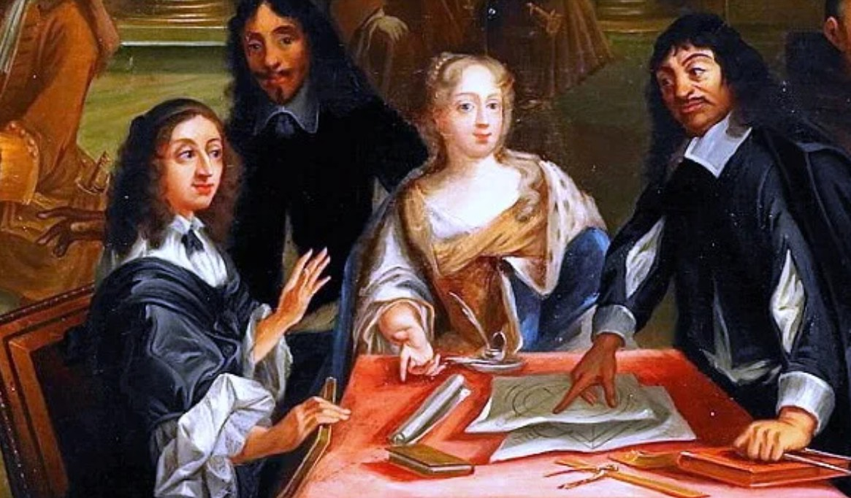
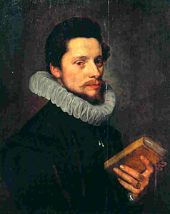

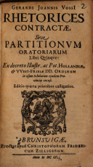
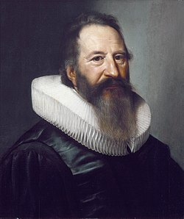
But other passions overtook her
1649 – 1654: Kristina plonged herself in her studies, committing policy-making to corrupt officers.
«A prince must think to himself as a slave crowned by the people».

Slide 8
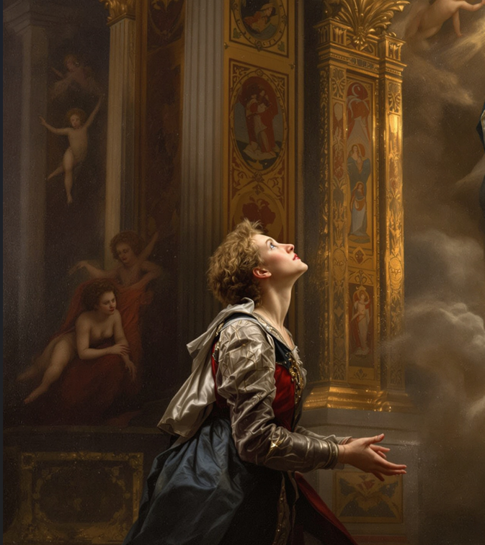
Conversion to Catholicism
«By whatever gate we enter Eternity, it is a gate of triumph».
«We may easily be heroes or saints in the opinion of others, but we must be saints after God’s fashion».

Slide 9
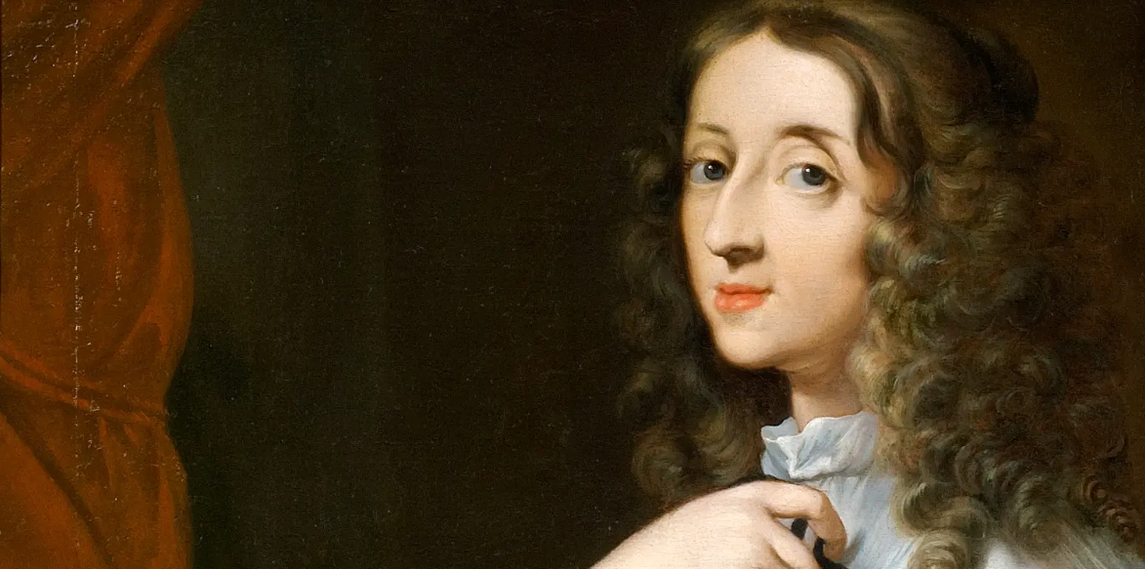
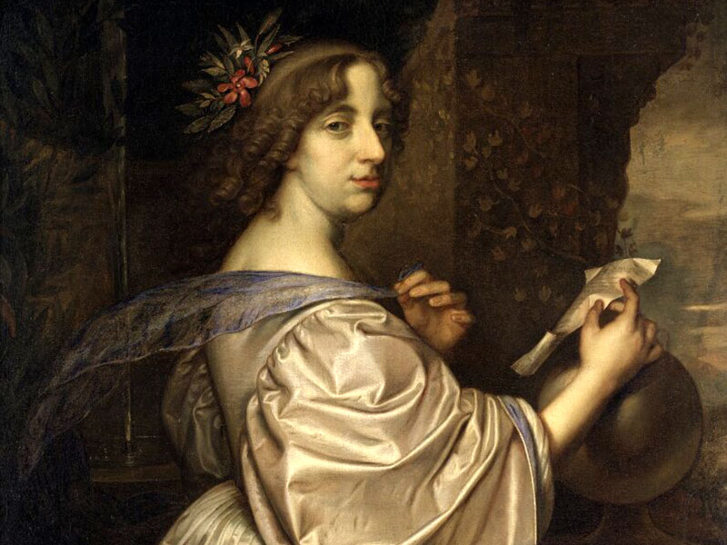
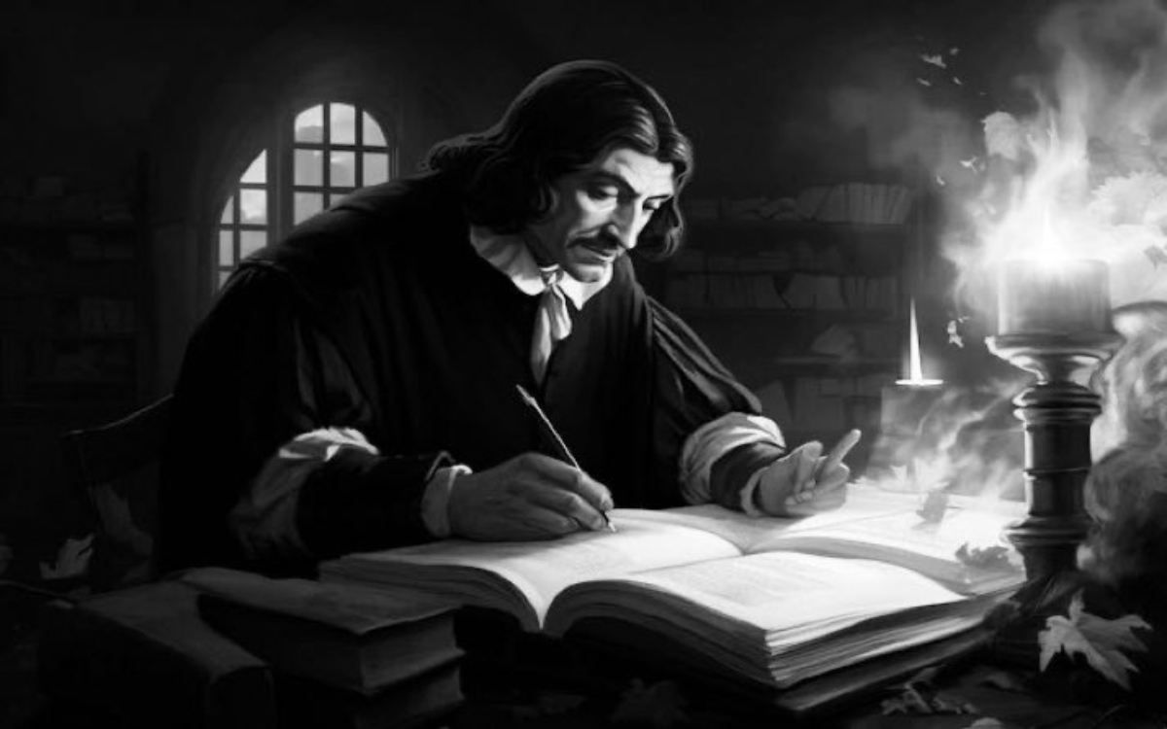
Why Catholic?
2. Just need for a more relaxed sexual morality?
1. Just a pretext to leave the throne?
3. Descartes?

Slide 10
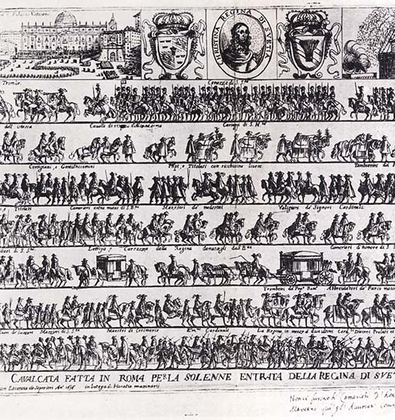
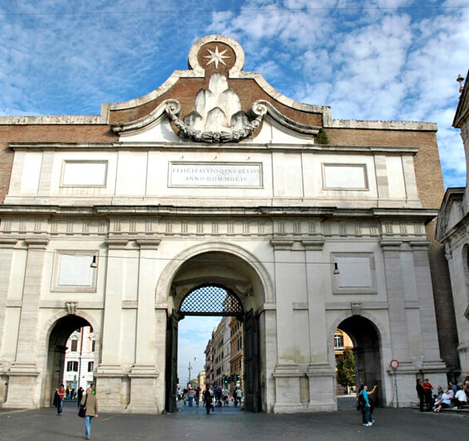
1655: Kristina moved to Rome

Slide 11
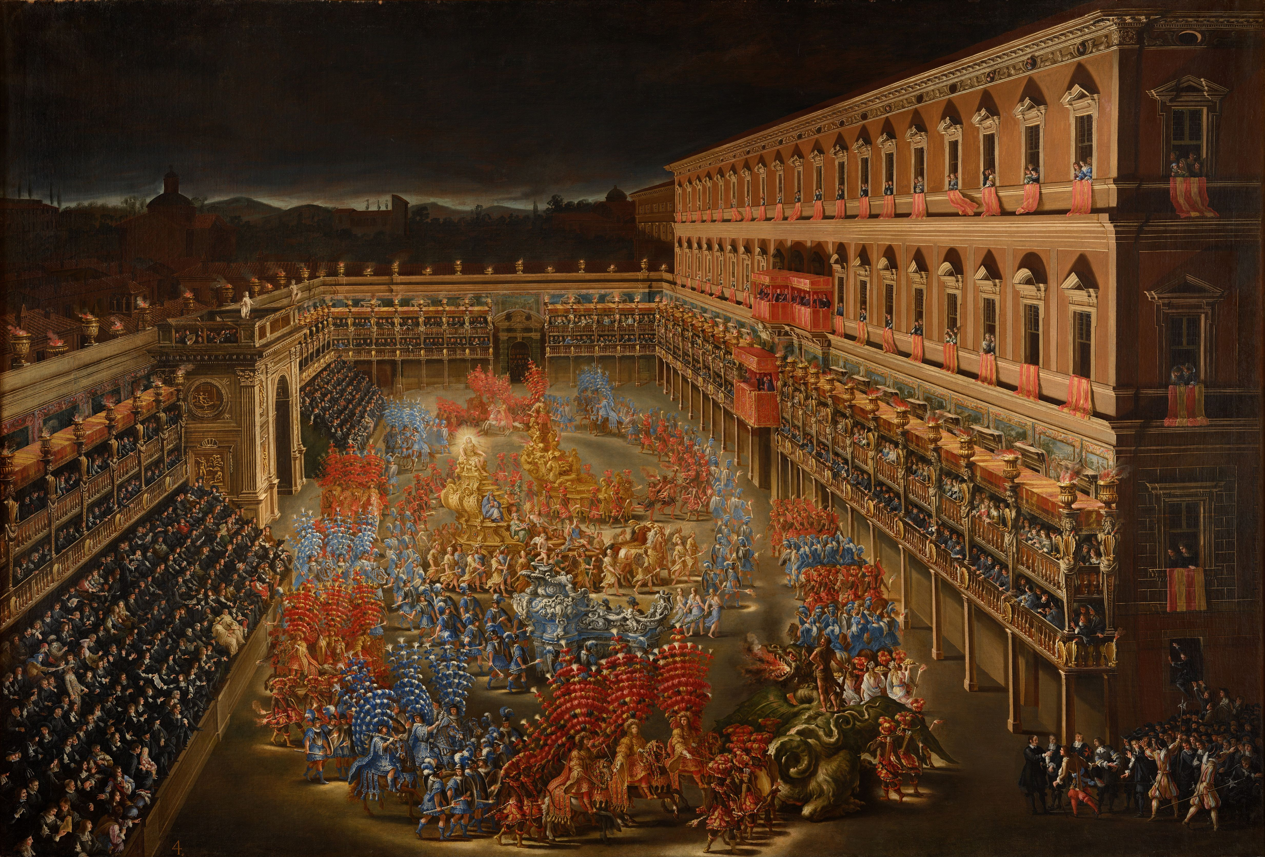
The Giostra dei Caroselli organized in the first night that Kristina spent in Rome

Slide 12
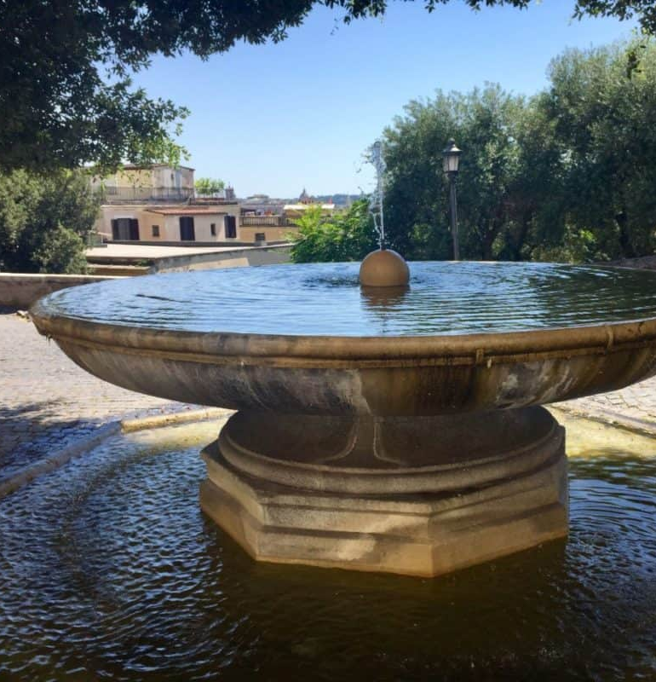
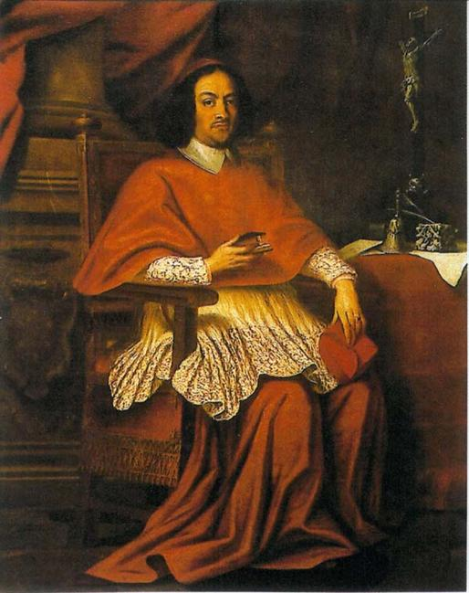
First love affairs

Slide 13
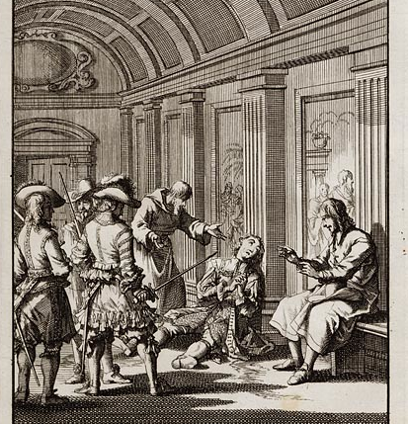
Failed plots
In 1657 Kristina tried to become queen of Naples with the help of the French, but was betrayed by a nobleman and ordered to kill him as revenge, spreading scandal.
«She is a queen without realm, a Catholic without faith and a woman without modesty».
- Pope Alexander

Slide 14
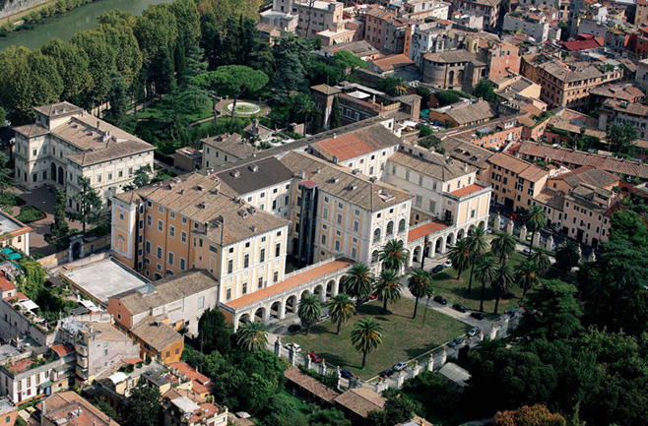
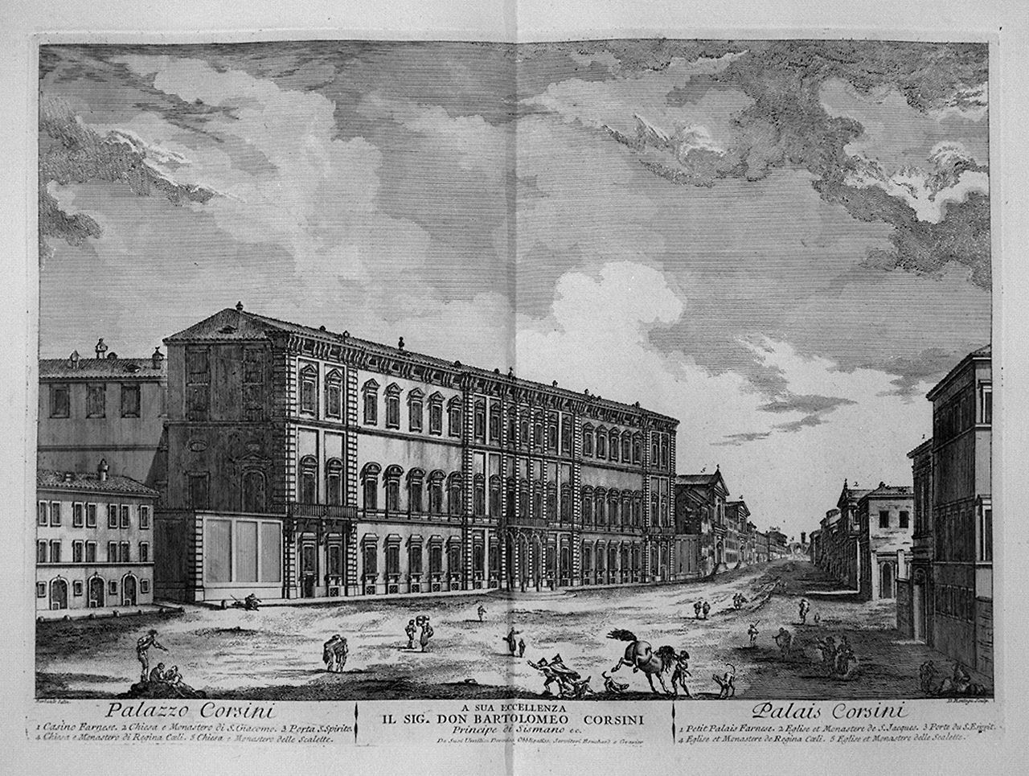
1659: a royal residence by the Tiber
«The most pardonable of all idolatries is that of the Sun».

Slide 15
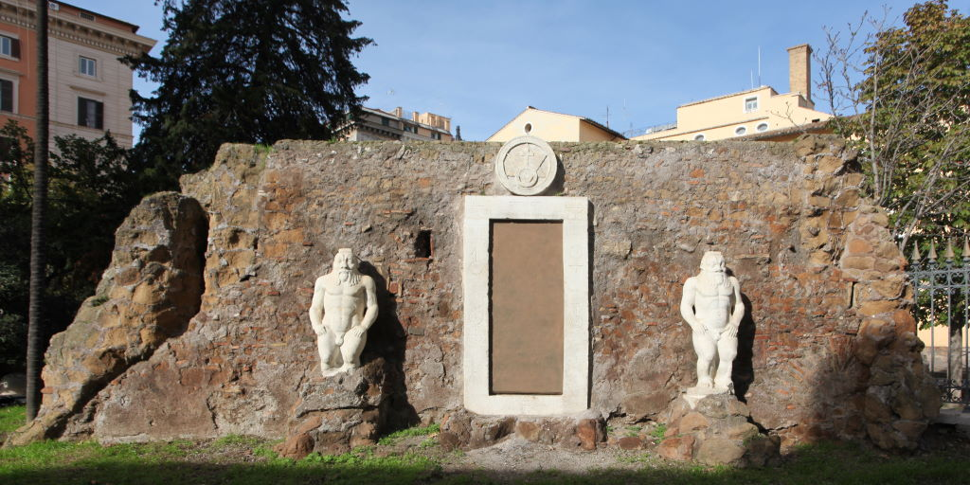
The alchemic circle
«Chemistry is a beautiful science. It’s like the anatomy of Nature, the key to every treasure».

Slide 16

The Royal
Academy of Rome
«In her company, a lot of people are starting to taste how beautiful are natural thoughts, and are starting to write on real topics».

Slide 17
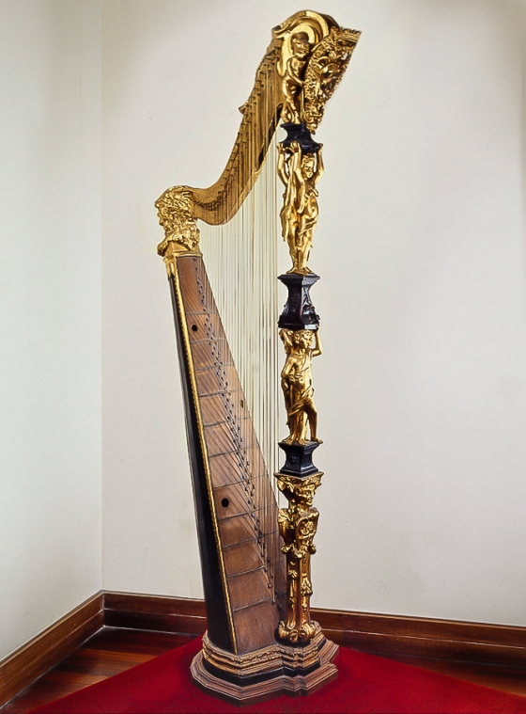
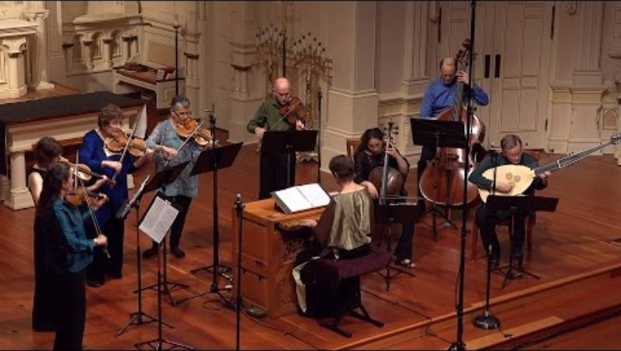
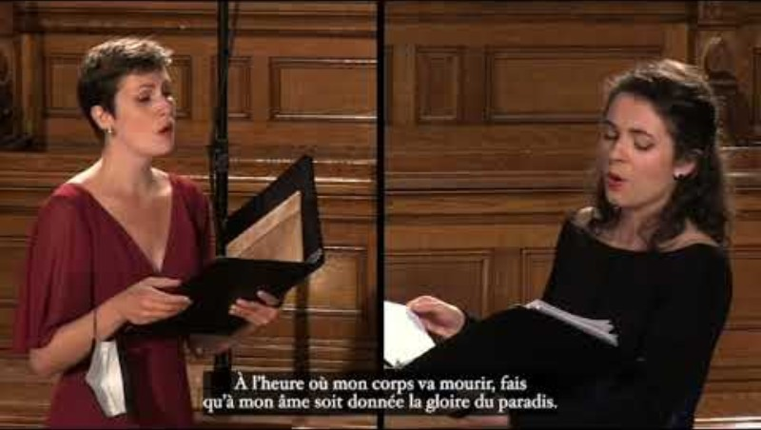
Concerts

Slide 18
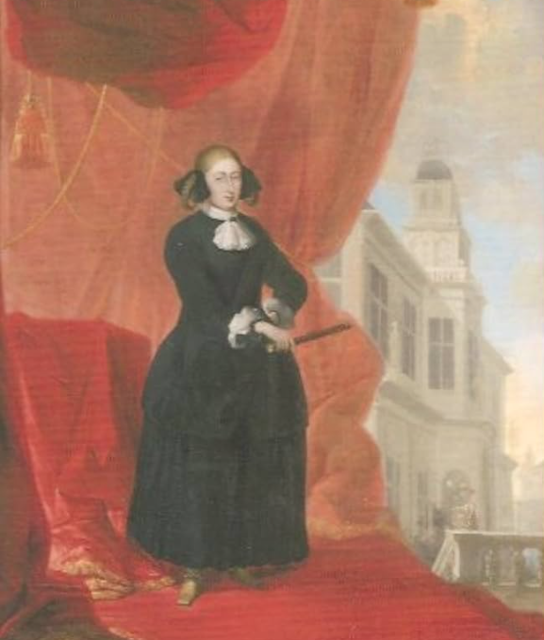
Theatre
Kristina established the Tor di Nona theatre. She allowed it to perform out of the Carnival weeks and hired for the first time 75 female singers and dancers instead of castrati.
«Passions are the salt of life. We can’t be neither happy or unhappy except in their exercise».

Slide 19
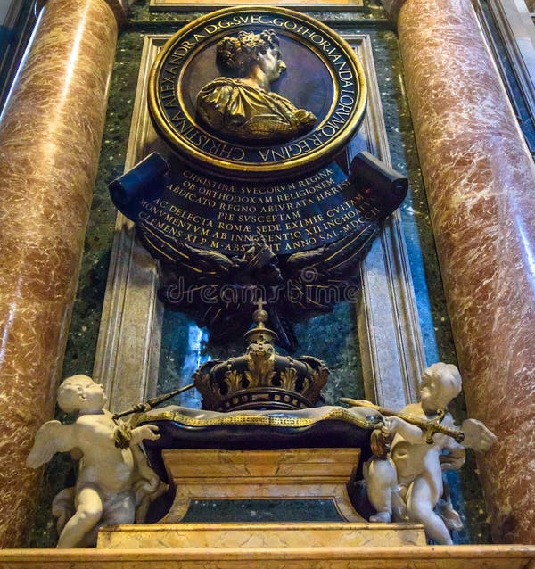
Death
(1689)
Kristina is the only female ruler buried in
the Vatican Caves, beside Mathilde of Canossa.
«Old age is worst than death.
It exists to confort one while he dies».

Slide 20
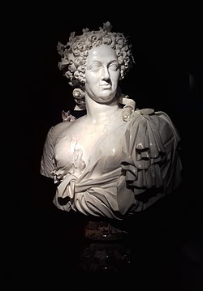
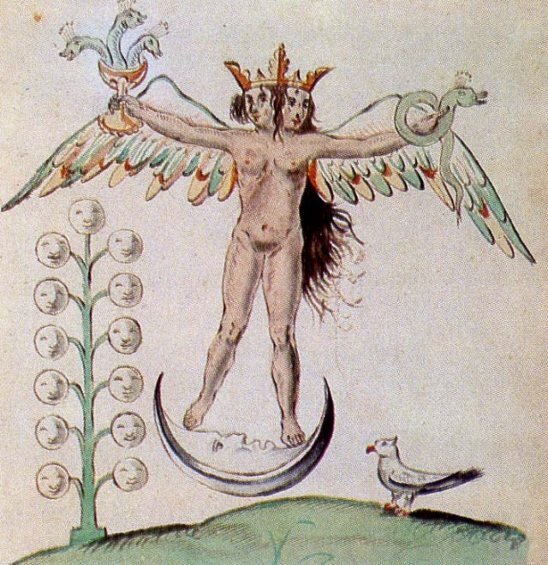
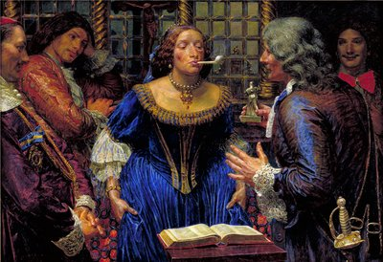
Modern explanations
Libertinism?
Royal status?
Androgynism?

Slide 21
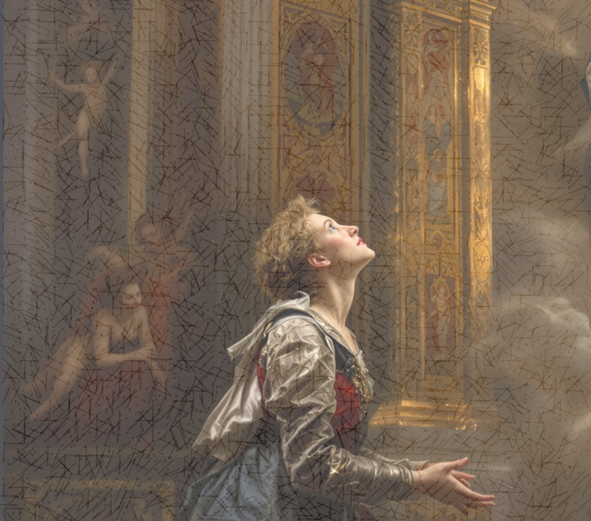
«Thou, God, hast given me a heart that nothing will content: with alarming ingratitude it counts as nothing the graces Thou hast showered on me.
Nothing can satisfy me but Thee. I ask Thee, for Thyself, by Thyself».
- Preface to Kristina’s autobiography

Slide 22
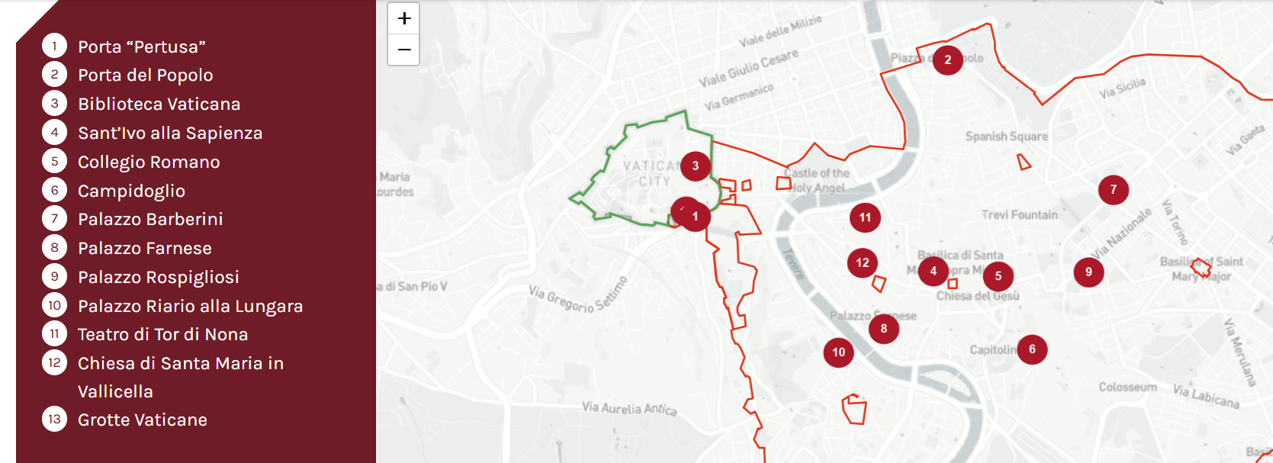
Kristina’s memories in Rome

