Slide 1
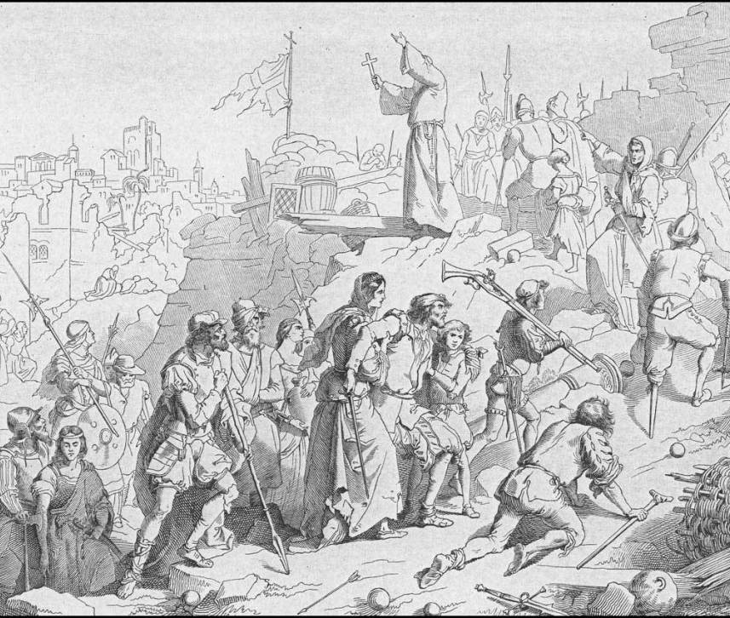
FROM MERCHANTS TO RULERS
Italians in Cyprus
1291 - 1571

Slide 2
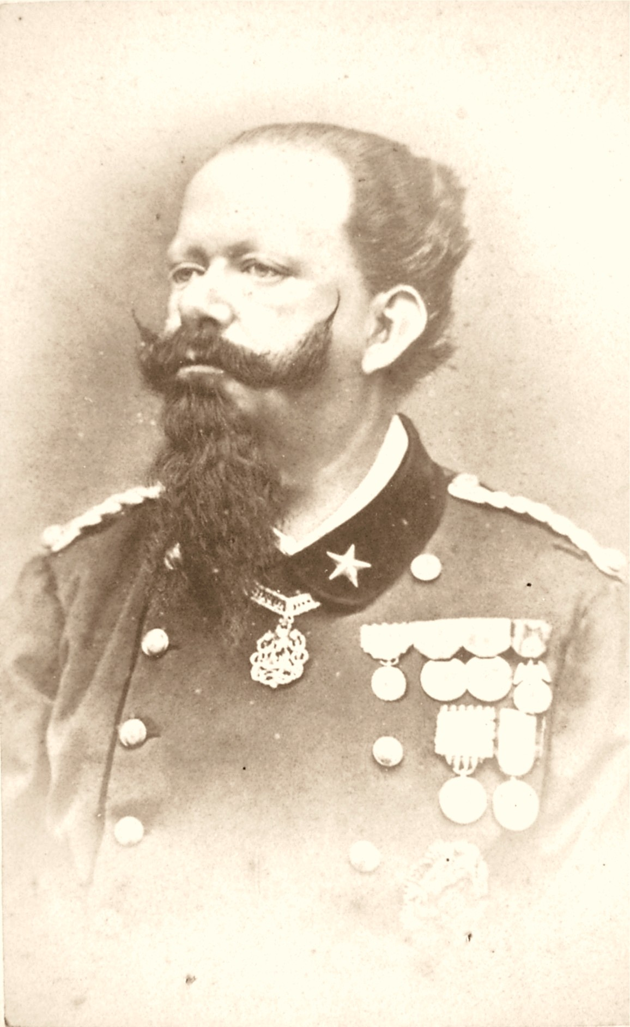
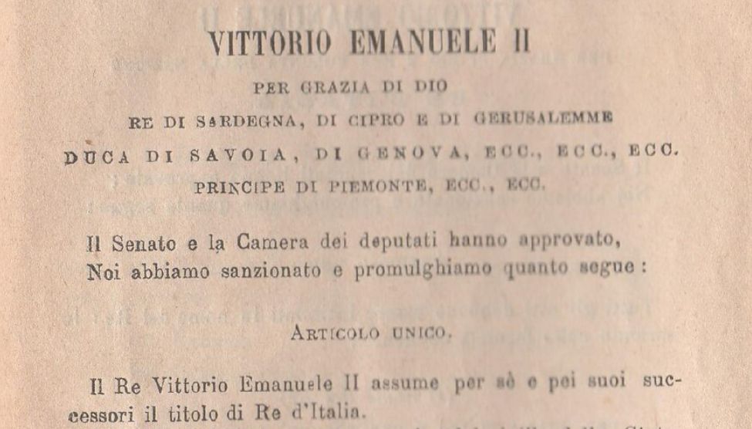
How happened that a «king of Cyprus and Jerusalem» became the first king of Italy
in 1861?

Slide 3
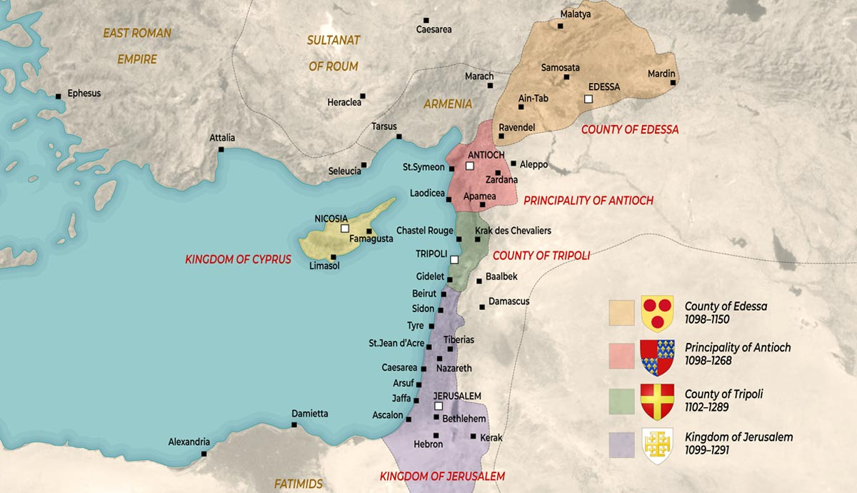
Let’s go back to the age of Crusades…

Slide 4
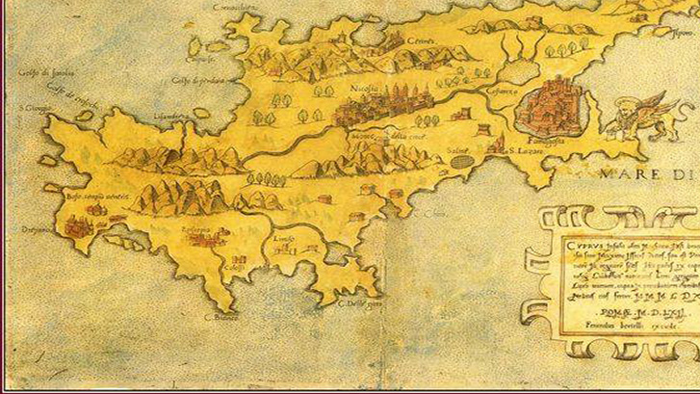
An island rich in resources

Slide 5
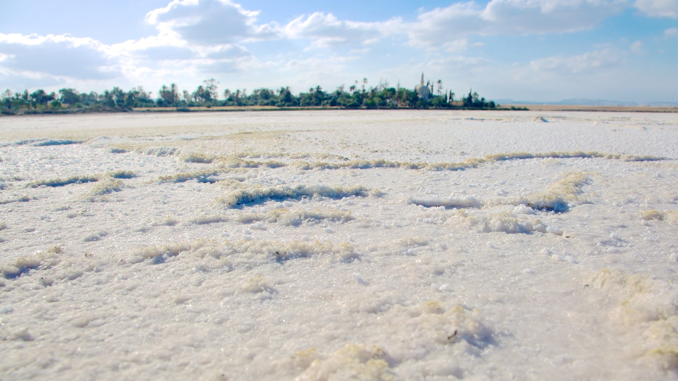
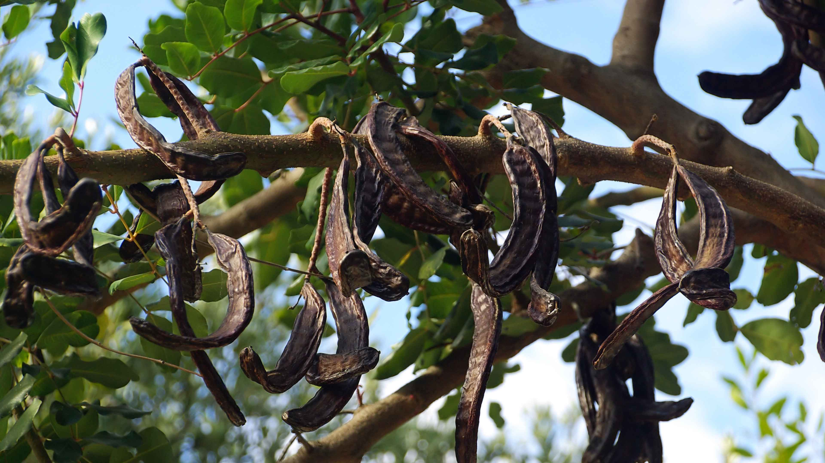
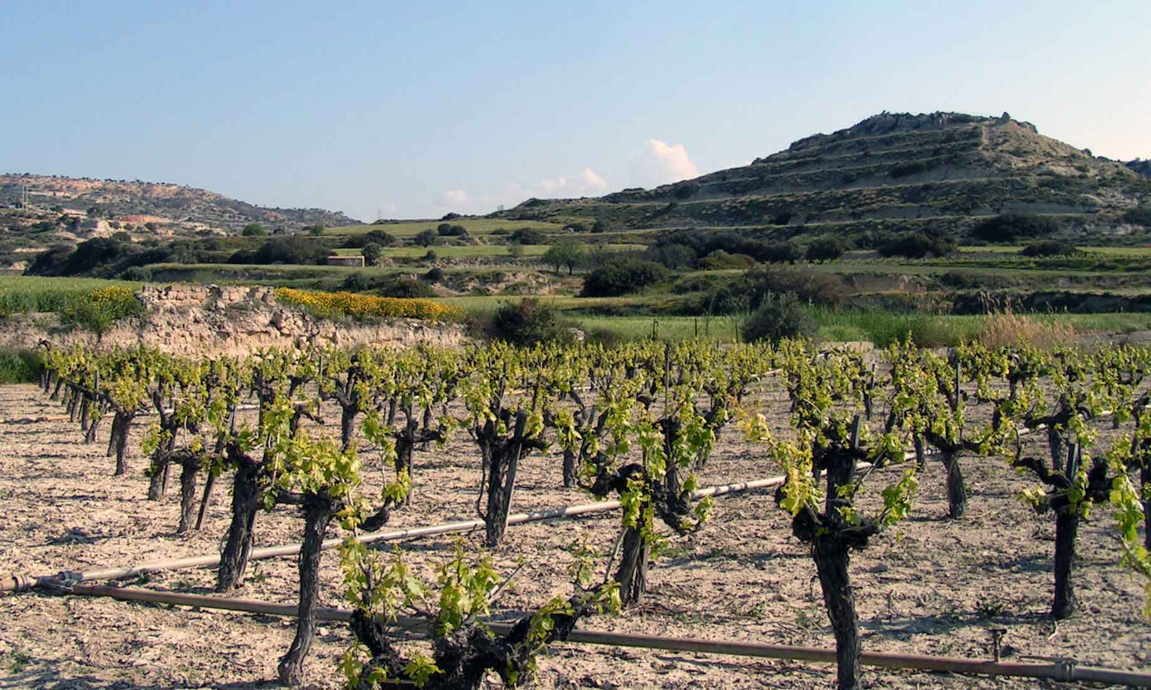
«Their salt is snow-white and extremely tasty»
«To drink their wine without losing your liver, you have to dilute it in 9-times more water»

Slide 6
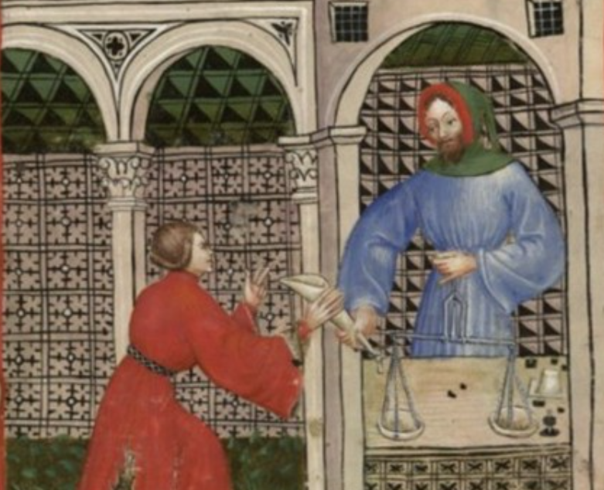
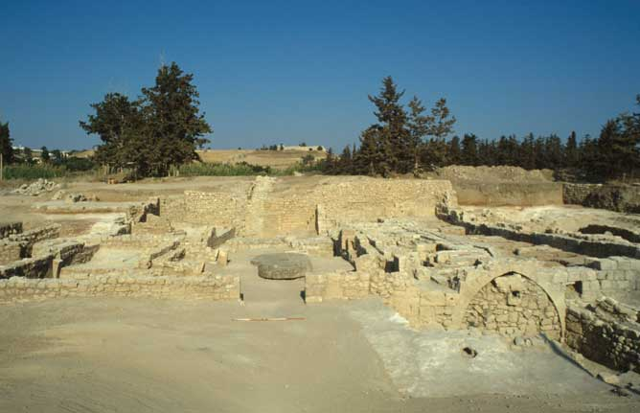
The only sugar producer in Europe
Rests of a sugar refinery in Kouklia

Slide 7
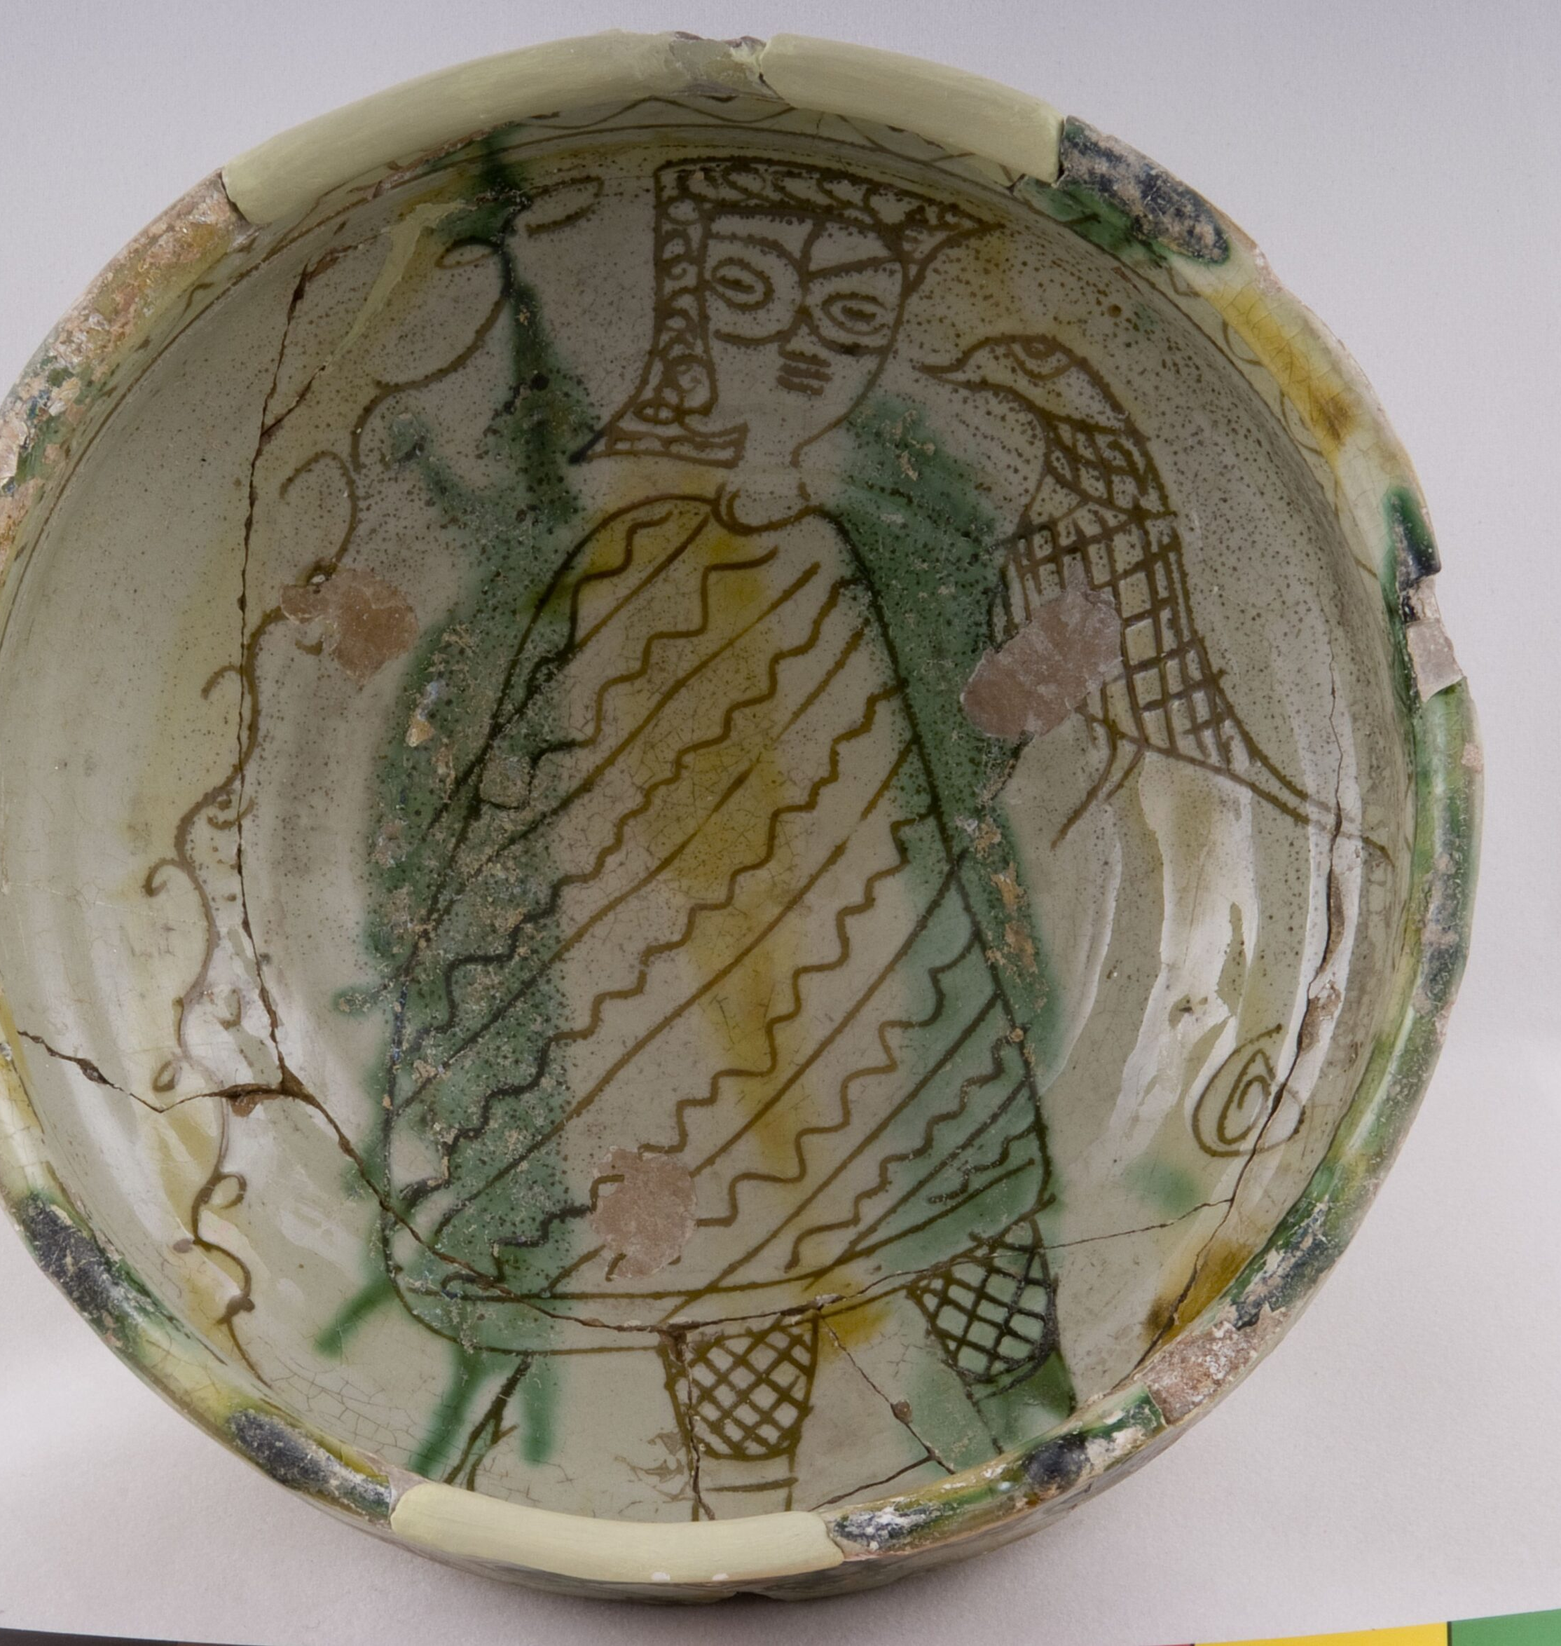
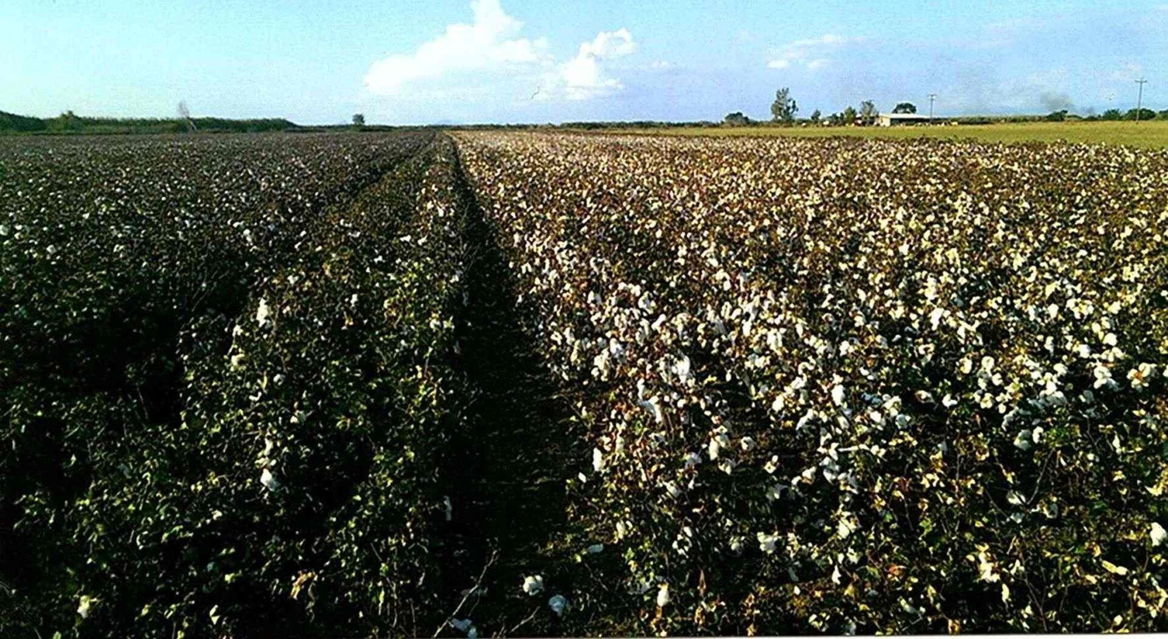
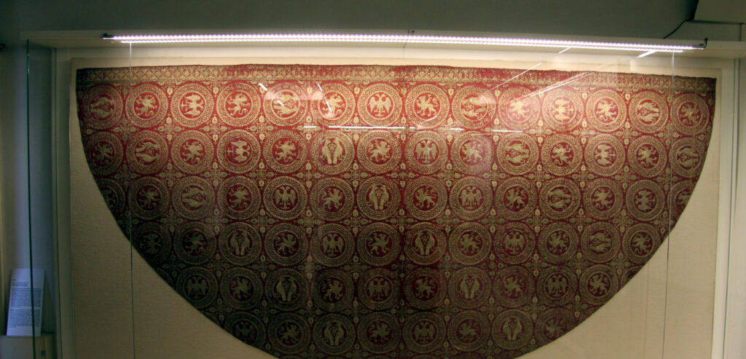

Slide 8
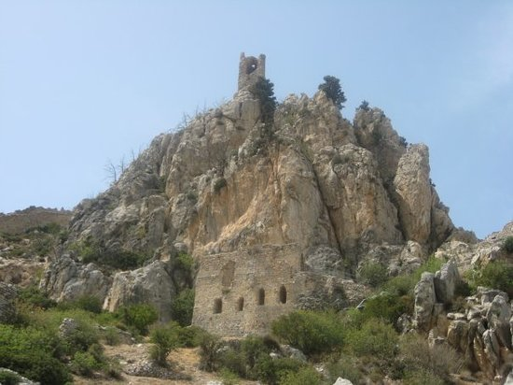
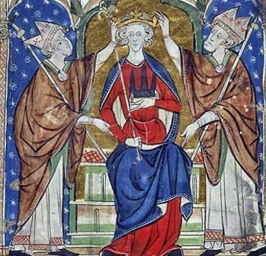
The Latin conquest: Guy de Lusignan
(late XII century)

Slide 9
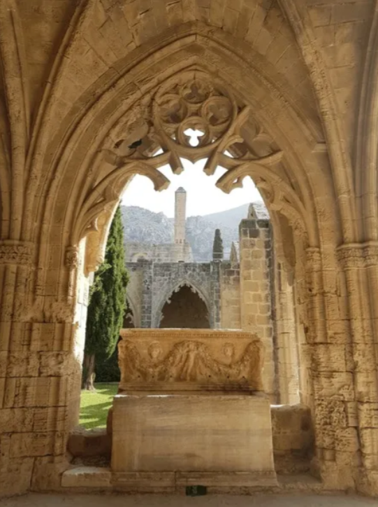
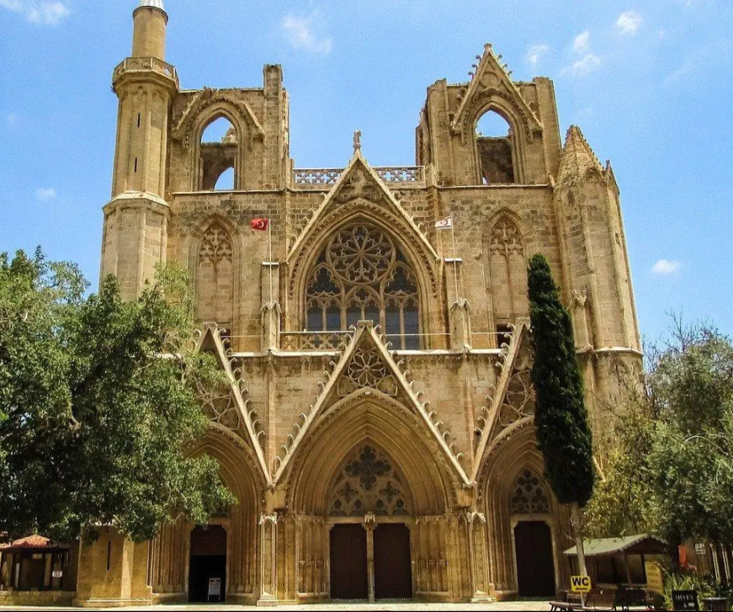
A French dynasty with Gothic taste…

Slide 10
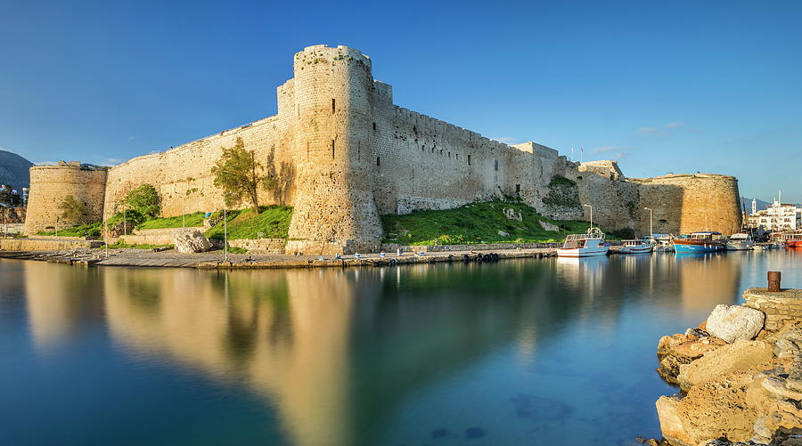
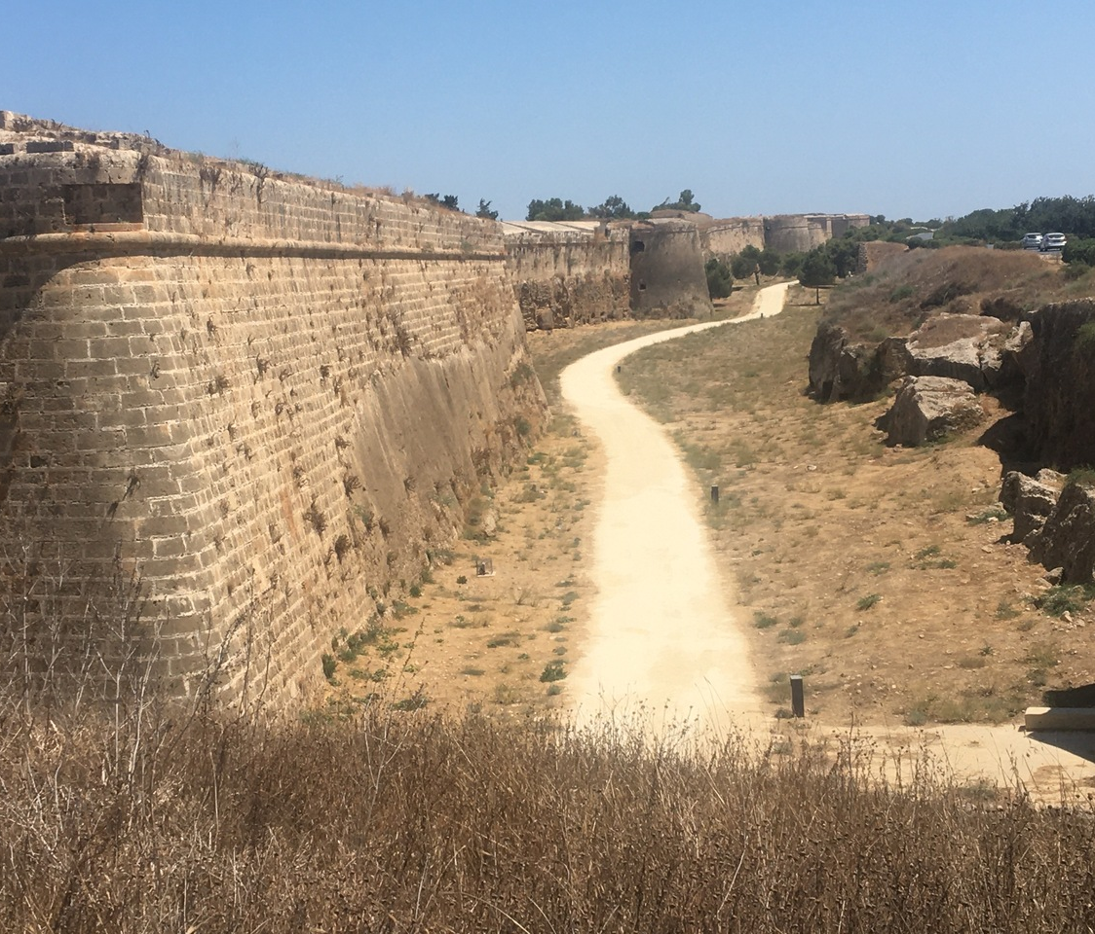
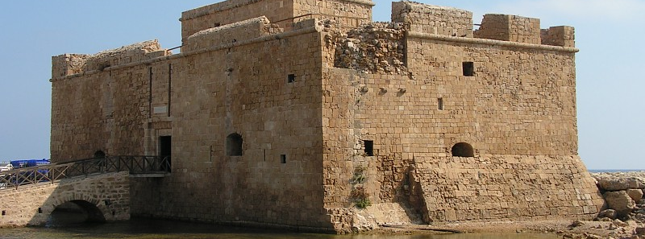
…which built a «Mediterranean Taiwan»

Slide 11
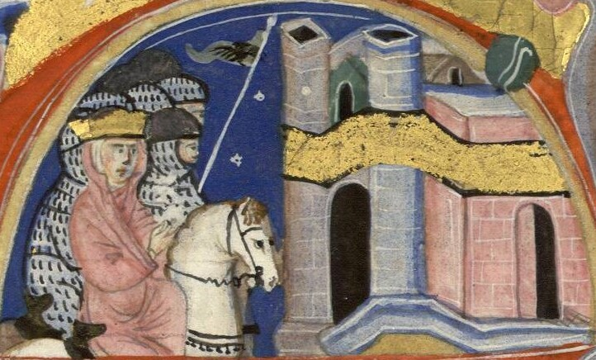
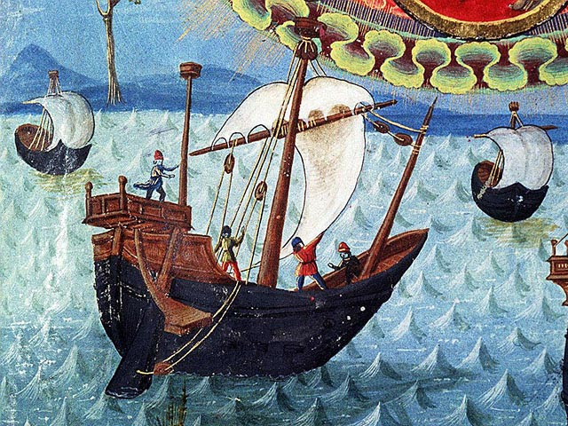
1218: Queen Alice granted trade privileges to the Genoese

Slide 12
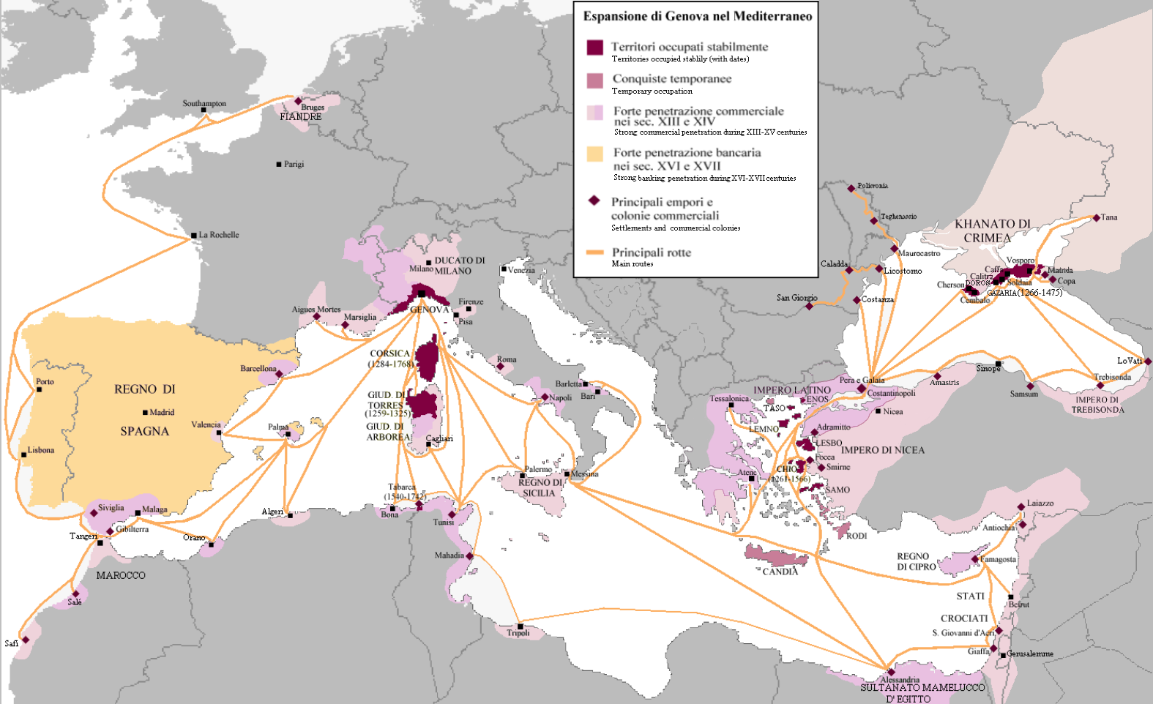
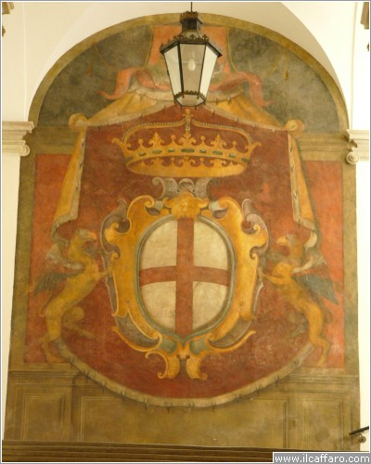
Genoa: the first multinational business empire?

Slide 13
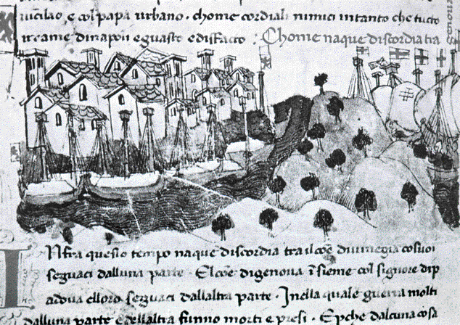
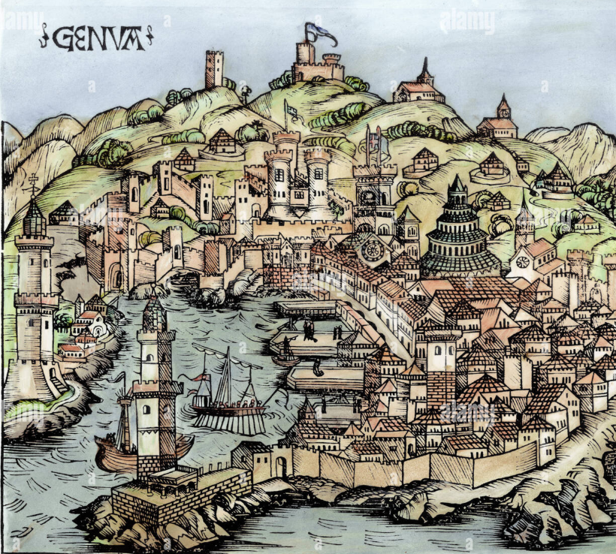
Starting from the early Crusades, Genoa built a full-fledged business system with its communes (colonies governed through the same political institutions of the capital), Genoese houses (bank branches), commendae (capital auctions), double-entry accounting and Genoins (first Western golden coins).

Slide 14
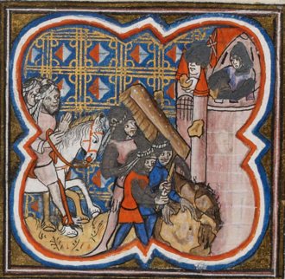
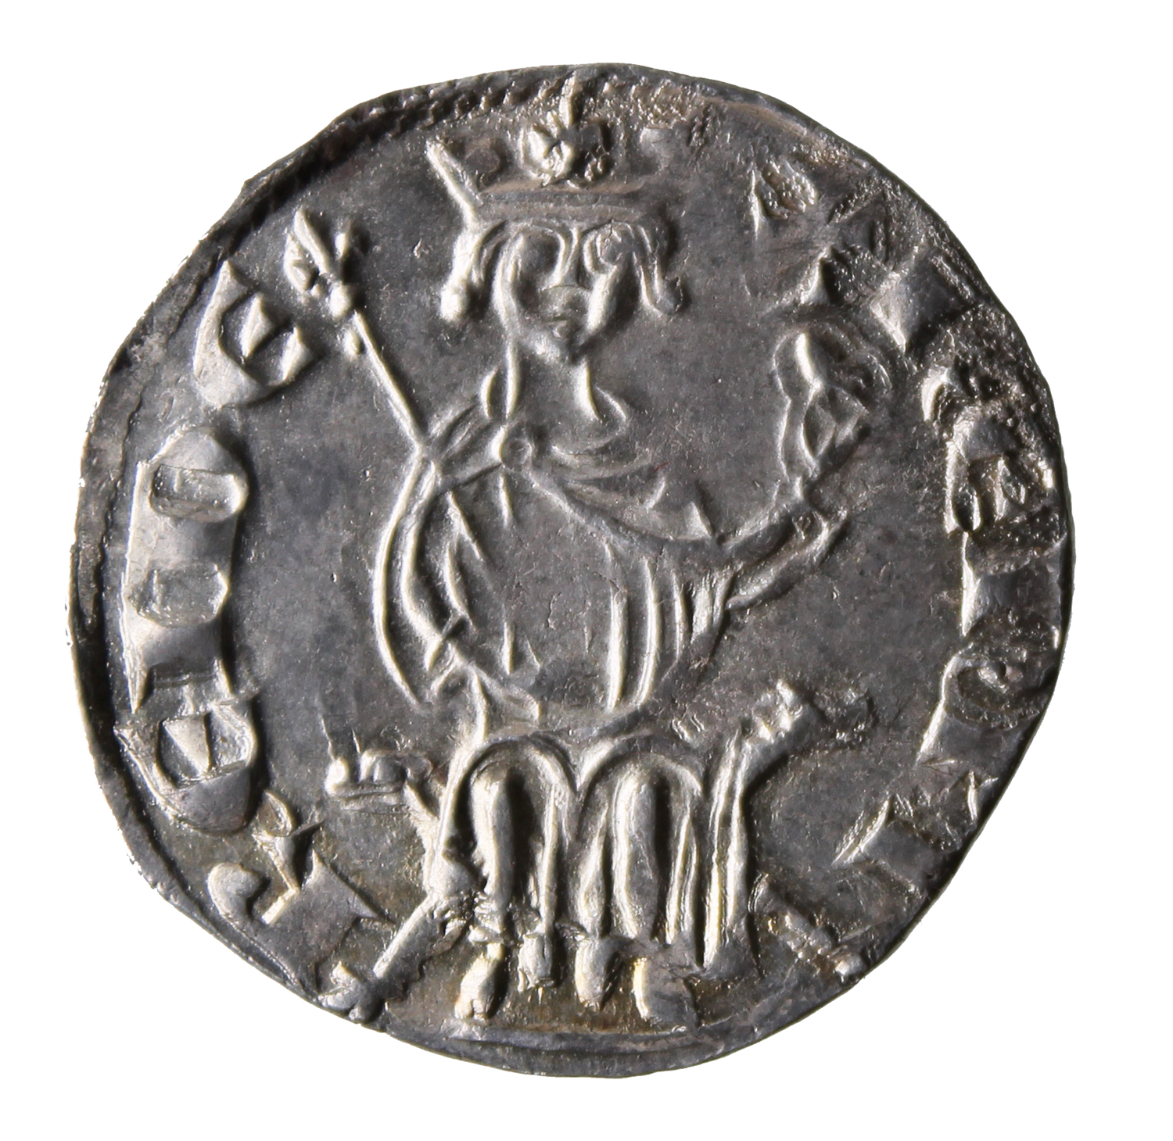
1306: King Henry II confirms trade privileges to Venetians

Slide 15
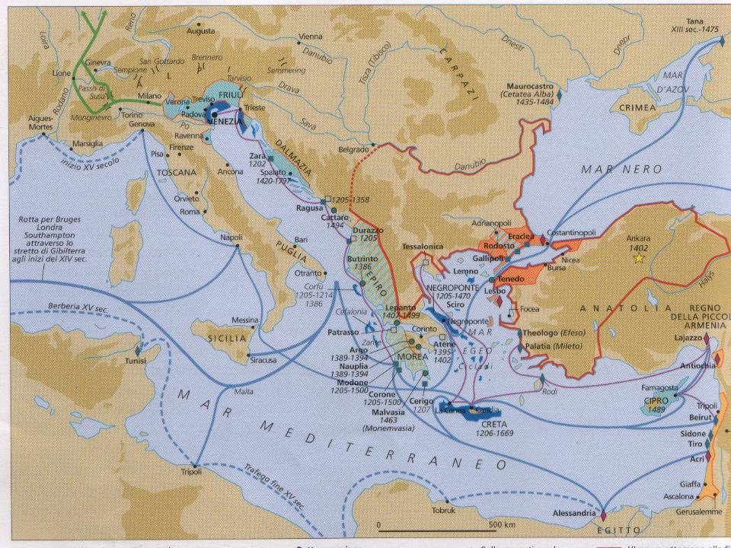
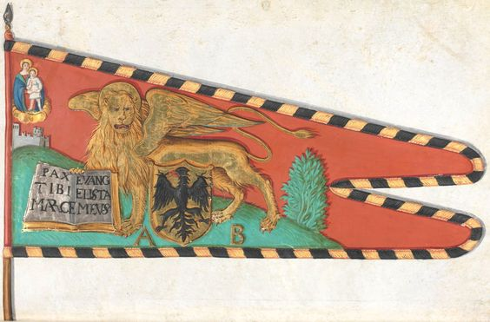
Venice: the rising power of the seas

Slide 16
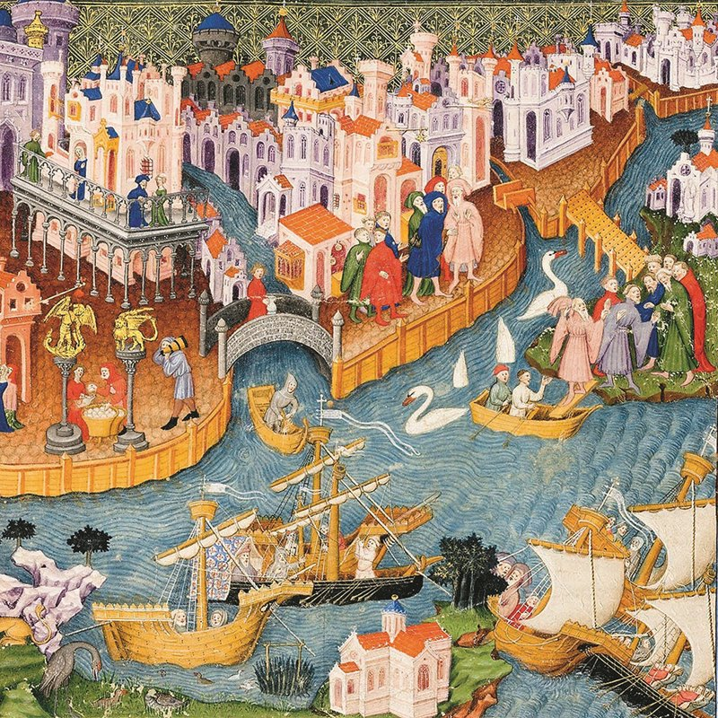
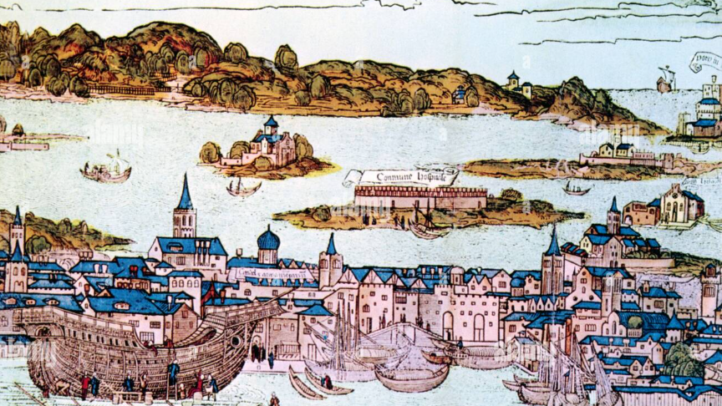

Slide 17
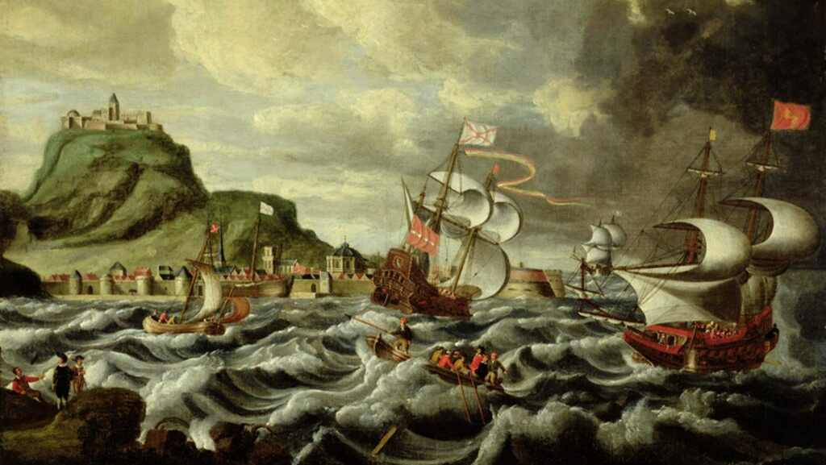
According to some figures, Venice and Genoa made up 70% of all ships in the Mediterranean during XIII and XIV centuries

Slide 18
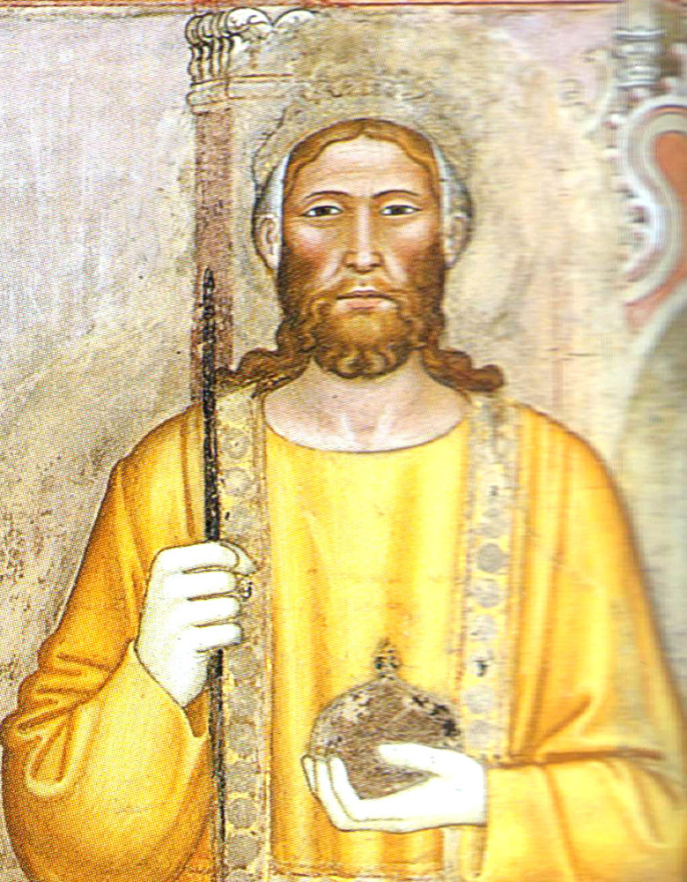
1374: the Genoese takeover
In 1369 king Peter I died in an ambush (caught by surprise while making love with his mistress). Three years later, his son Peter II came to age.
The Genoese podestà and the Venetian bailo fought for the honor of keeping the horse rein during the coronation march.
The Venetians and the natives massacred dozens of Genoese men.
A year later, as retaliation, a Genoese fleet blockaded the island and forced the young king to surrender Famagusta.

Slide 19
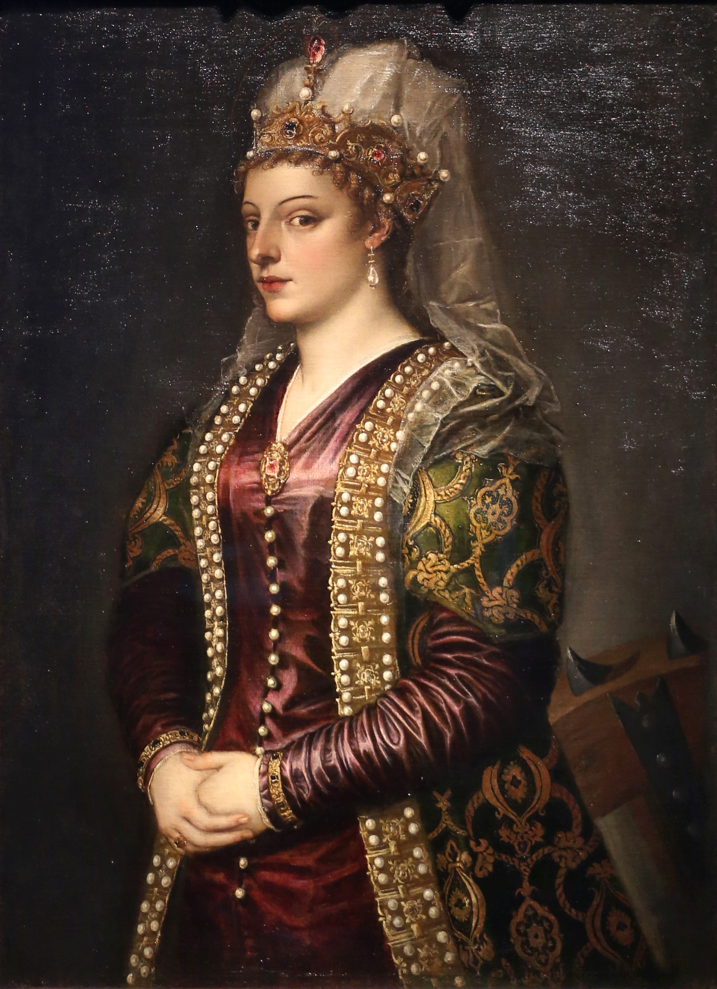
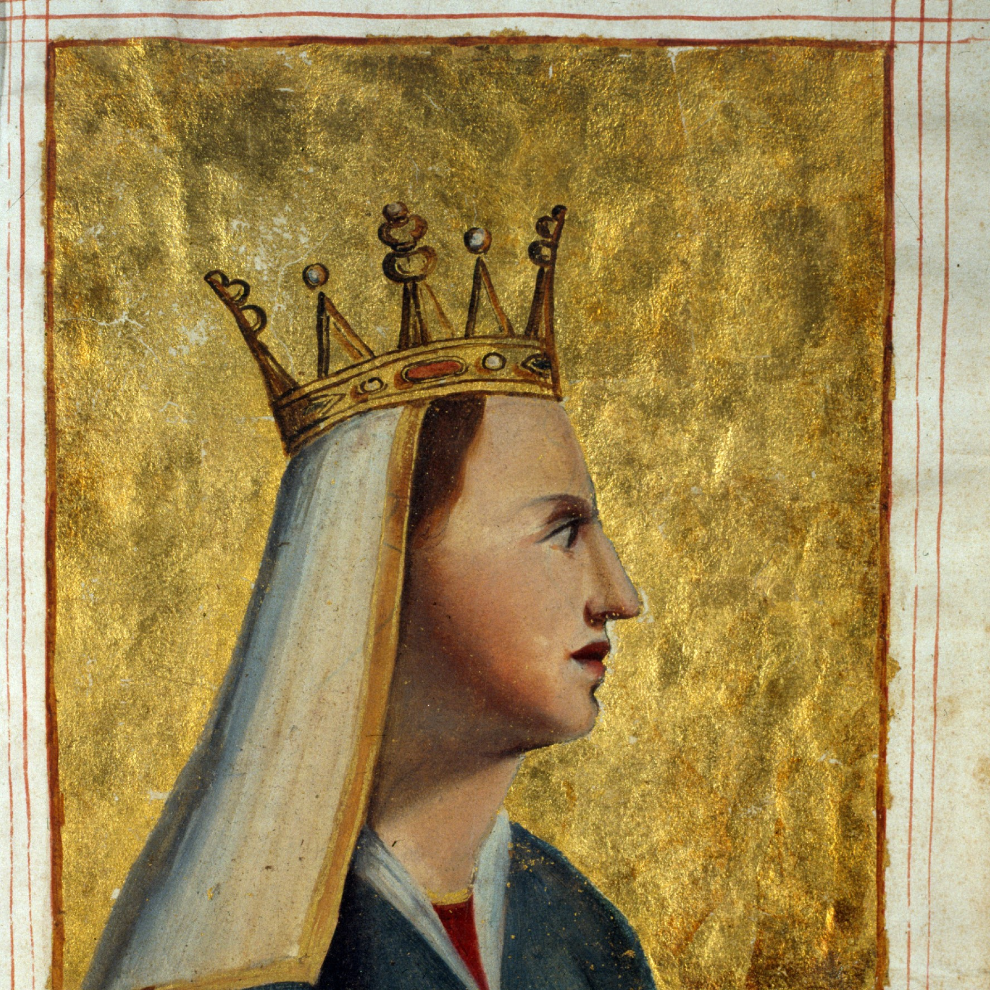
1489: the Venetian takeover
Charlotte of Lusignan (left) and Caterina Corner (right)

Slide 20
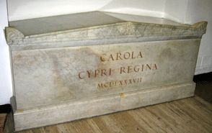
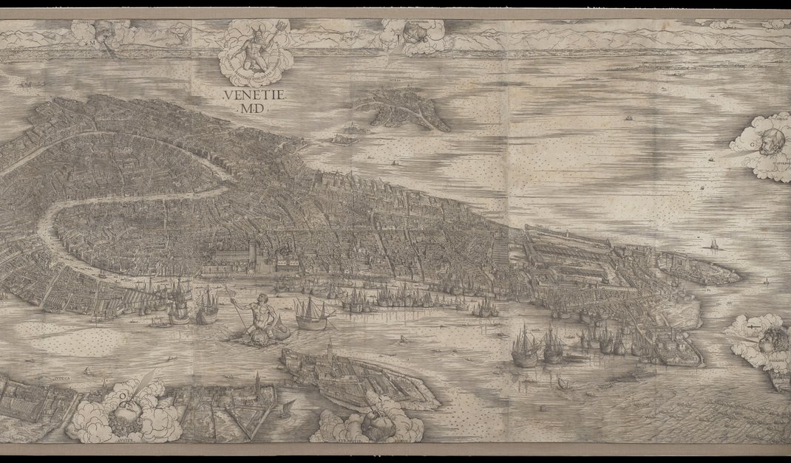
Caterina Corner married James of Lusignan, who died soon. Then she abdicated in favor of the Republic of Venice itself.
Charlotte married the duke of Savoy (allied of Genoa), hence the title «king of Cyprus and Jerusalem» that lasted until modern times.
Now she is buried in St.Peter’s Basilica.

Slide 21
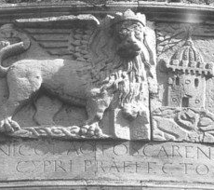
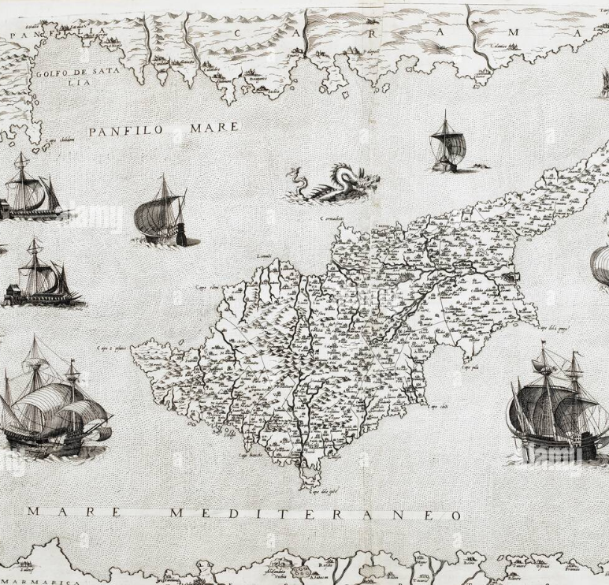
Cyprus, along with Crete, was the last asset for Venice after the discovery of the New World
(by Columbus, Genoese) and the opening of new Oceanic trade routes…
…but the Turks were at the peak of their expansion

Slide 22
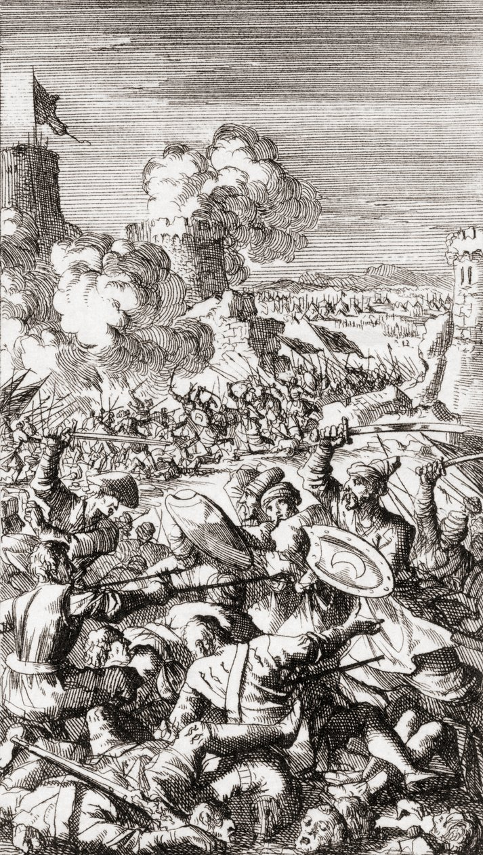
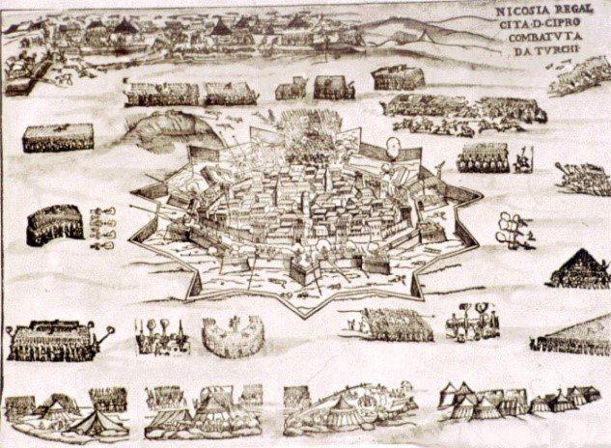
1570: the Turkish invasion
July-september: siege of Nicosia and slaughter of 20.000 christians

Slide 23
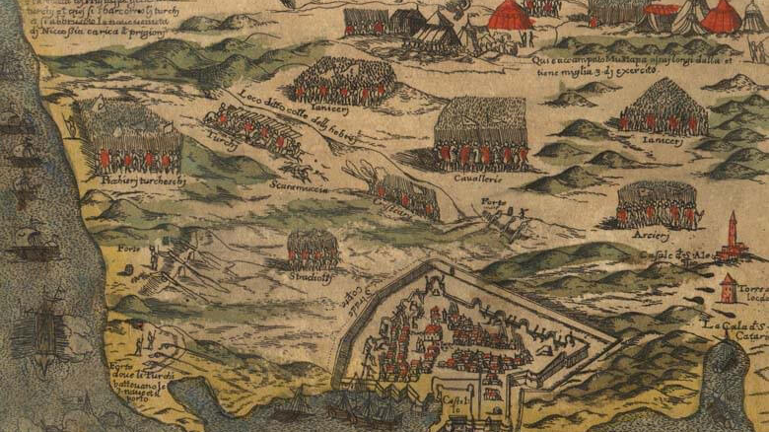
September 1570 – August 1571: Siege of Famagusta

Slide 24
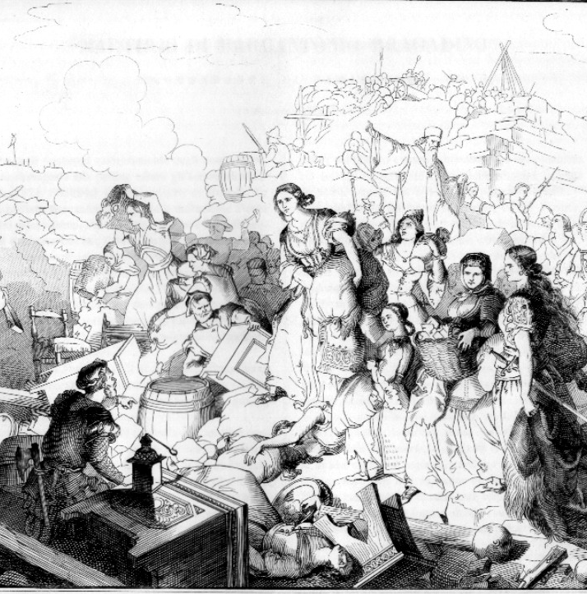
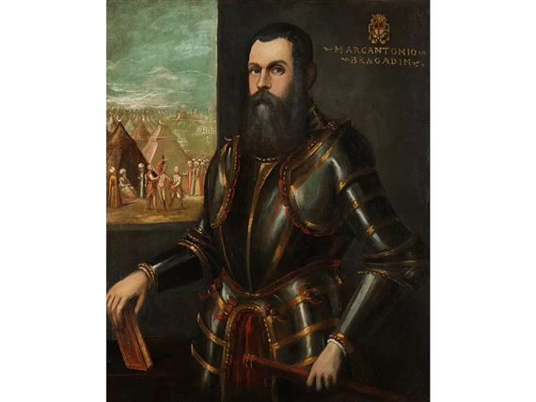
Marcantonio Bragadin resisted a whole year with only 8.500 men against more than 200.000 foes, putting out of combat 52.000 of them.
They negotiated only when no food and only 6 barrels of gunpowder remained.

Slide 25
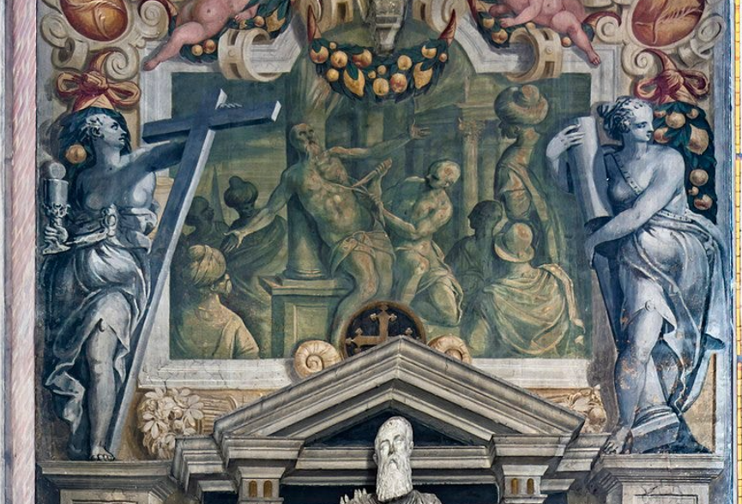
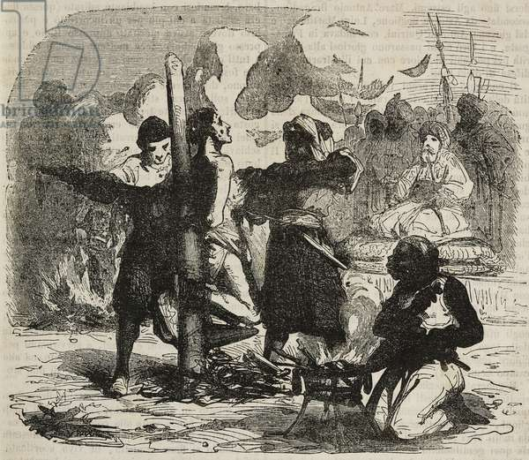
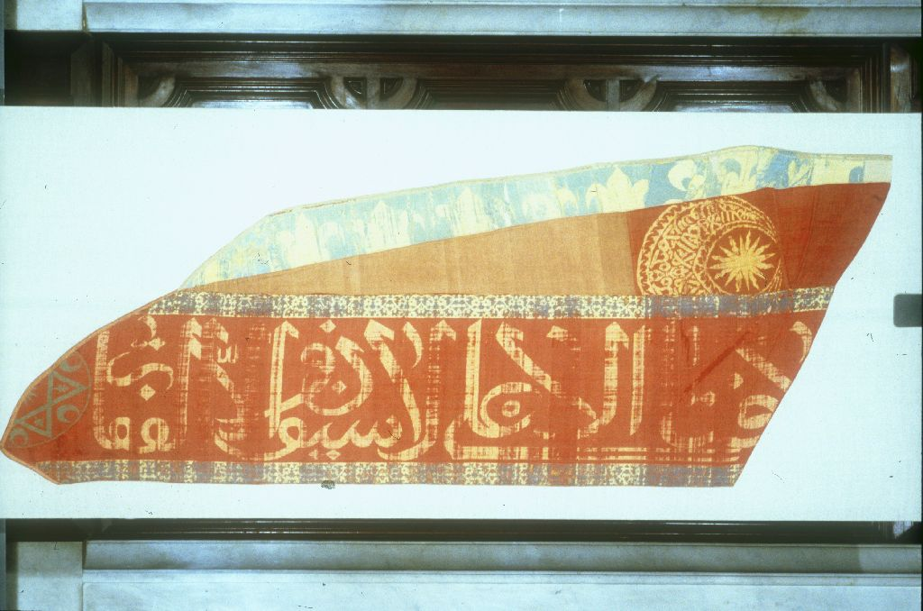
Against the terms of the surrender, Bragadin was mutilated, skinned and turned into a strawman, while all the male population of the city was slaughtered and the female population was enslaved.

Slide 26
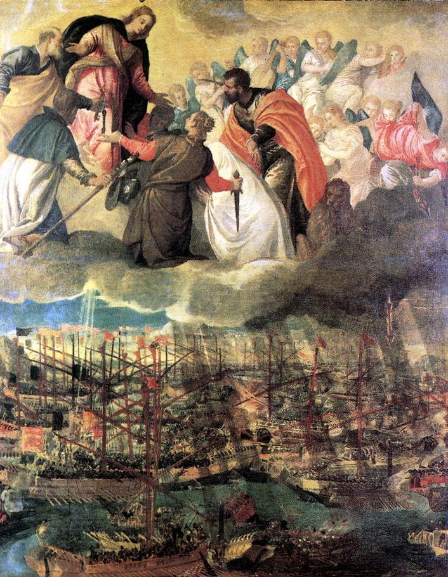
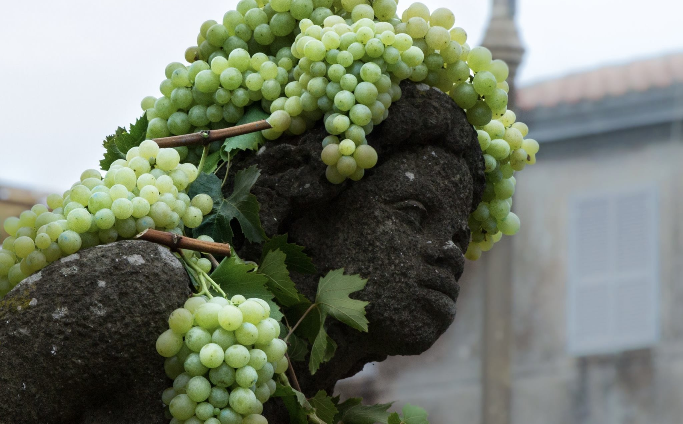
Two months later (October 7), the Holy League created by pope Pius V achieved the great victory of Lepanto.
However, the allies (expecially Genoa-funded Spain) refused to help Venice recovering Cyprus.

Slide 27

The mourning for 1570-71 war was shared between Cypriots and Italians. Memories of those days are kept alive also in Rome, starting from street names at the very edge of the Vatican.

