Slide 1
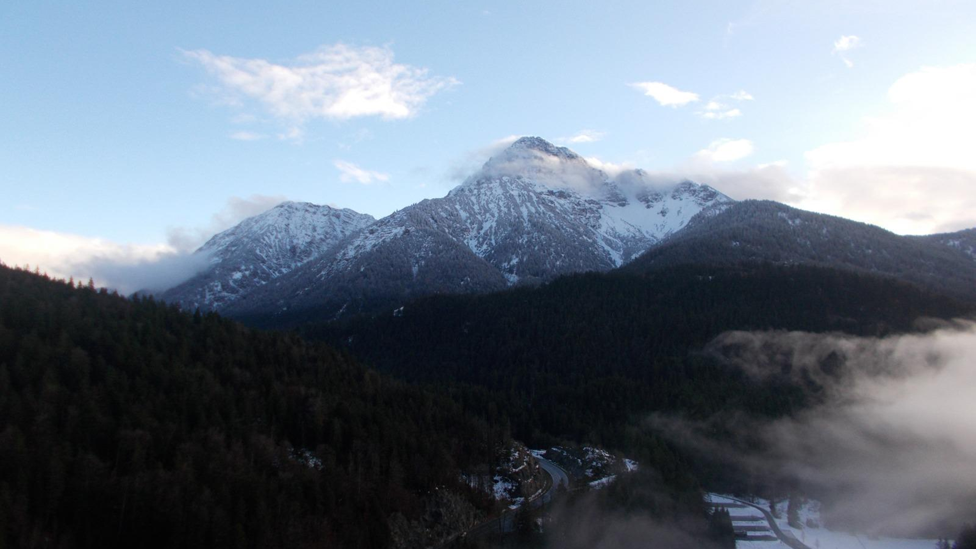

ERASMUS A ISNY

Slide 2
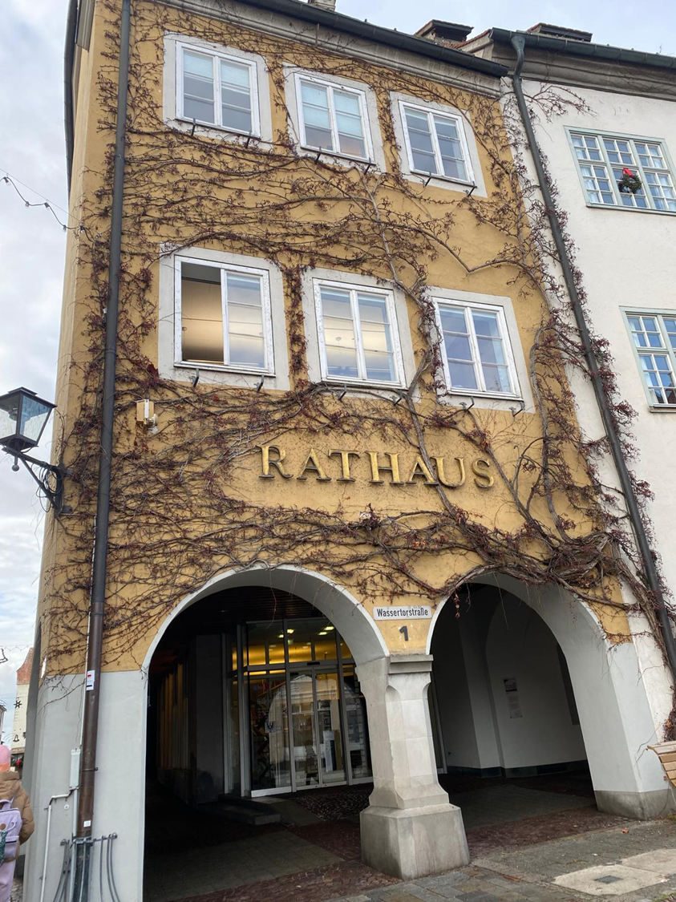

On December 1st, my other classmates and I left for Erasmus in Germany. During this week we were hosted at home by a group of German boys, precisely from Isny, a little town. This week we spent 24 hours a day with these guys and did a lot of activities with them.
Spending so much time with them I was able to understand and learn their culture different from ours, and I could also see the difference between us teenagers who grew up in a big city and compared to them growing up in a small city with few inhabitants.
This is a picture from a shop in center of Isny

Slide 3
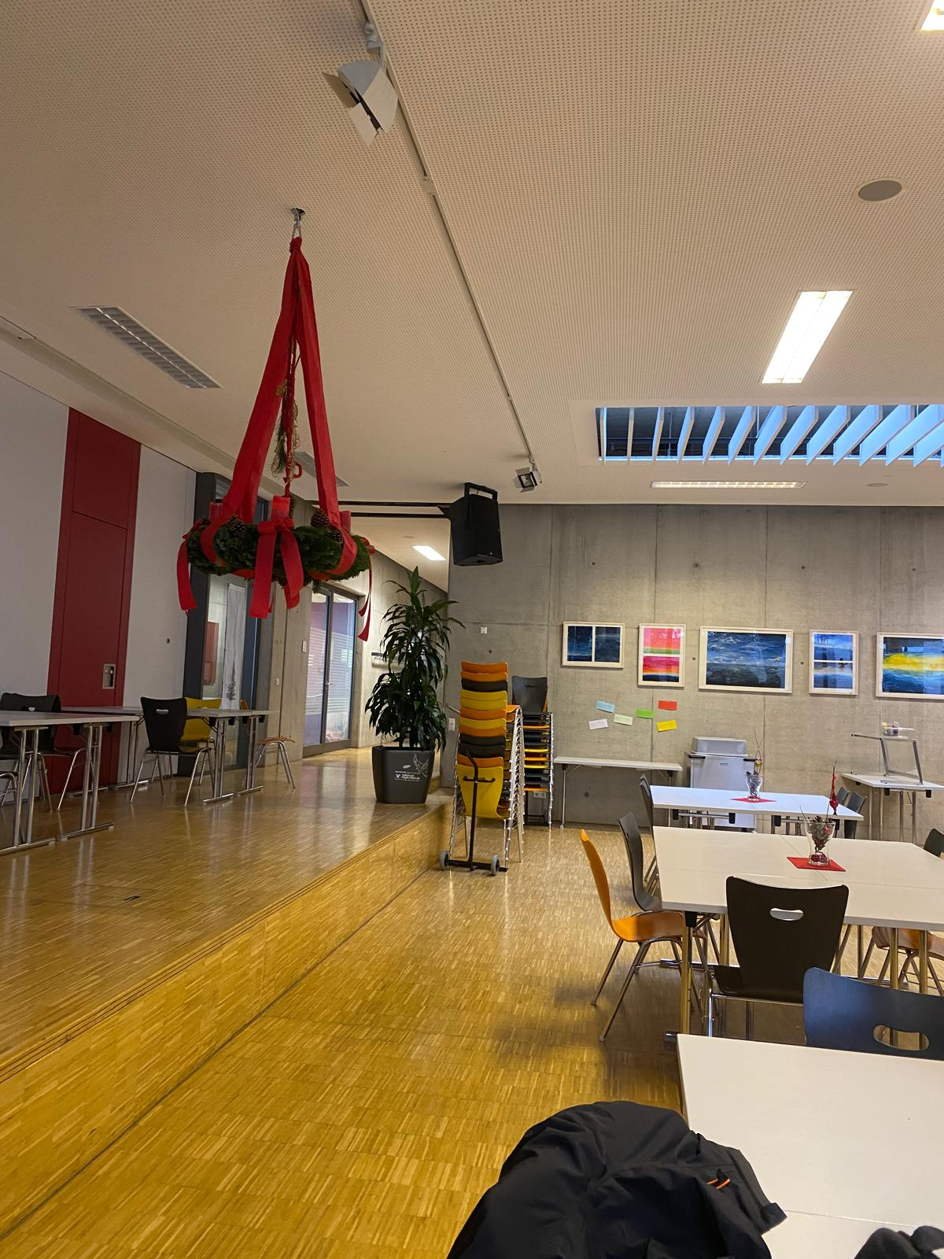

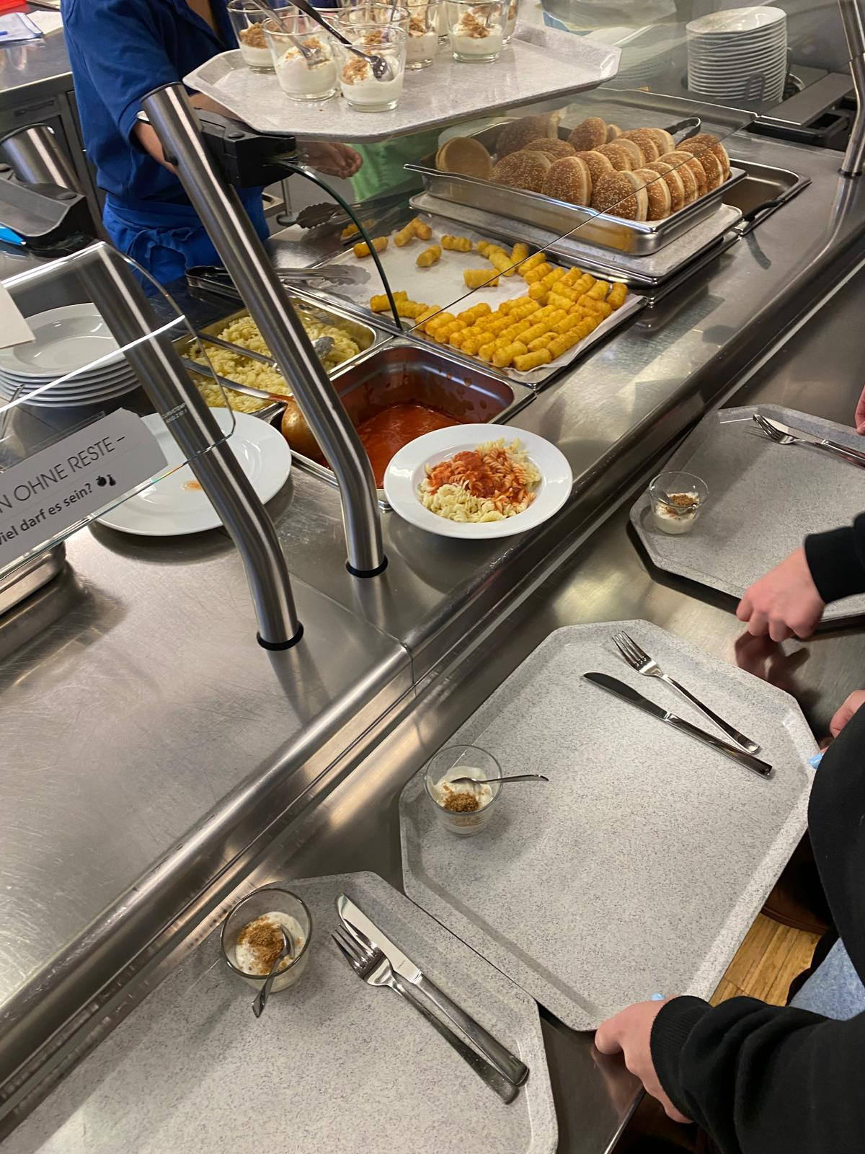
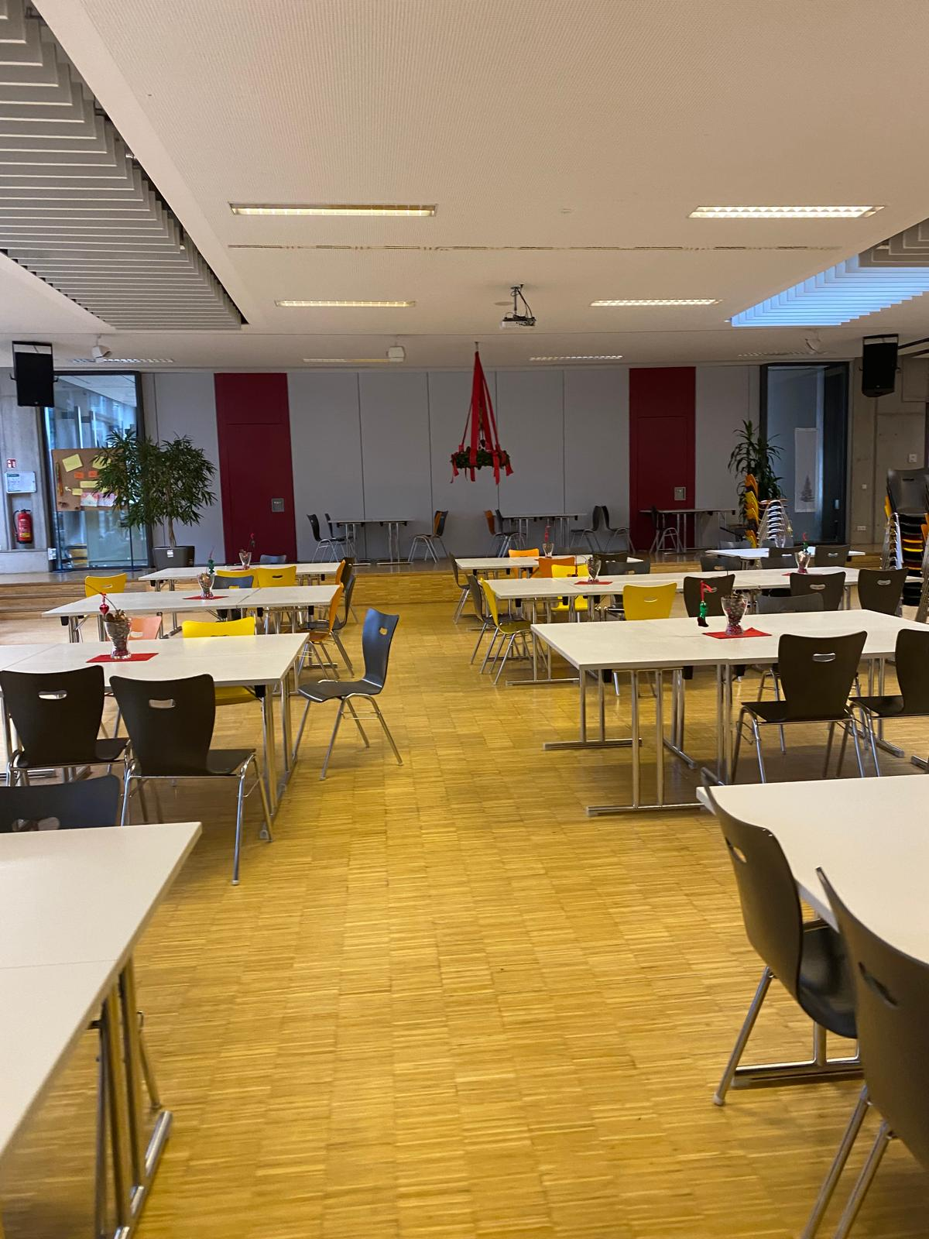
SCHOOL
The first difference between the Italian school and the German school is that they start school at 7.30, we instead start at 8.00.
When they have an hour free they can go home or maybe at the supermarket to buy the lunch. That is one of the things that surprises me the most.
They also have a huge canteen where they can relax in the free time or to have a snack in the break.

Slide 4
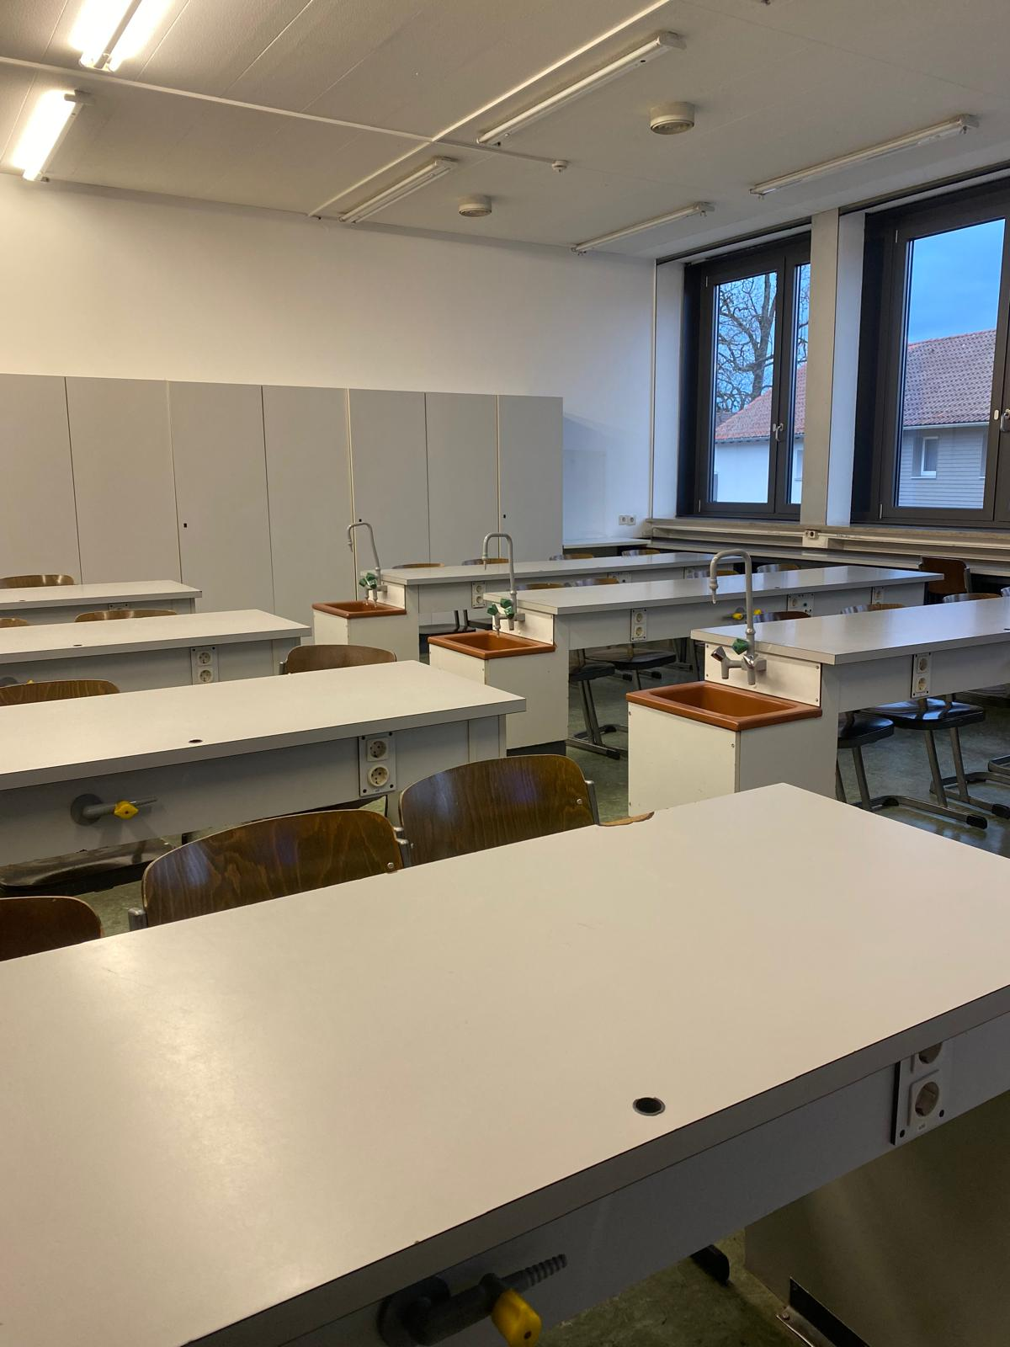
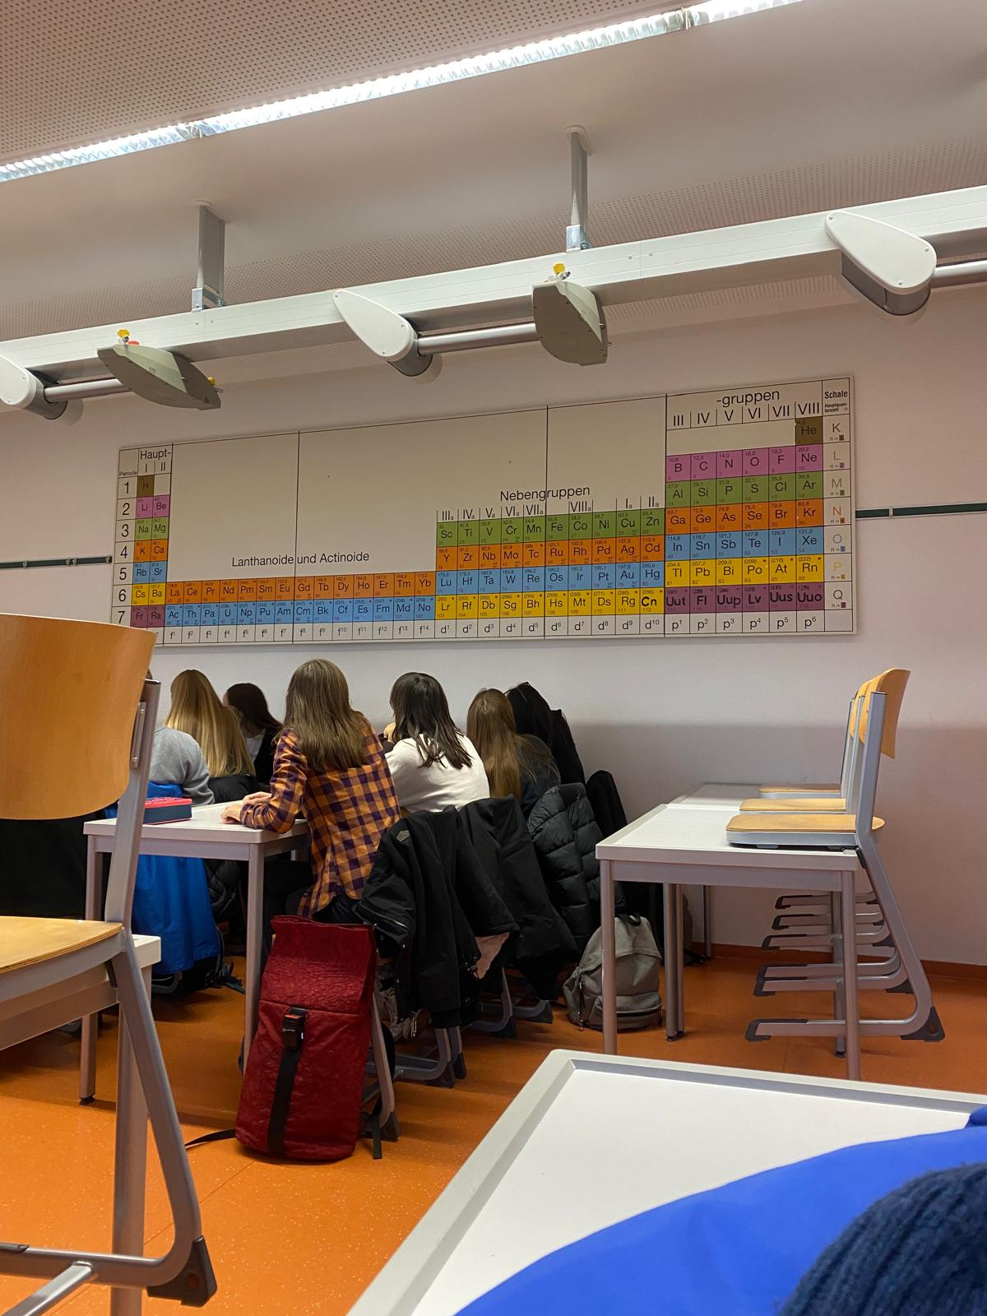
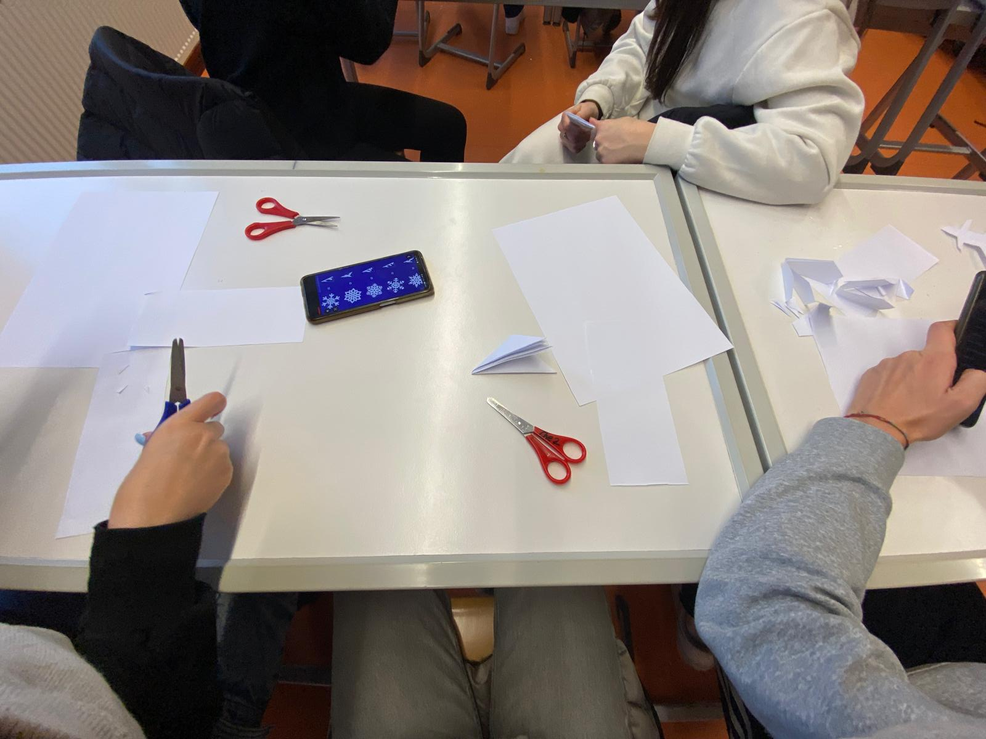
THE CLASS
Another difference is that they have one class for every subject unlike us that we have just a single class for every subject. In fact there every teacher has their personal class.
Their classes are really well-stocked and ordered. An example is the class of biology or chemistry that have also the sink near every table.

Slide 5


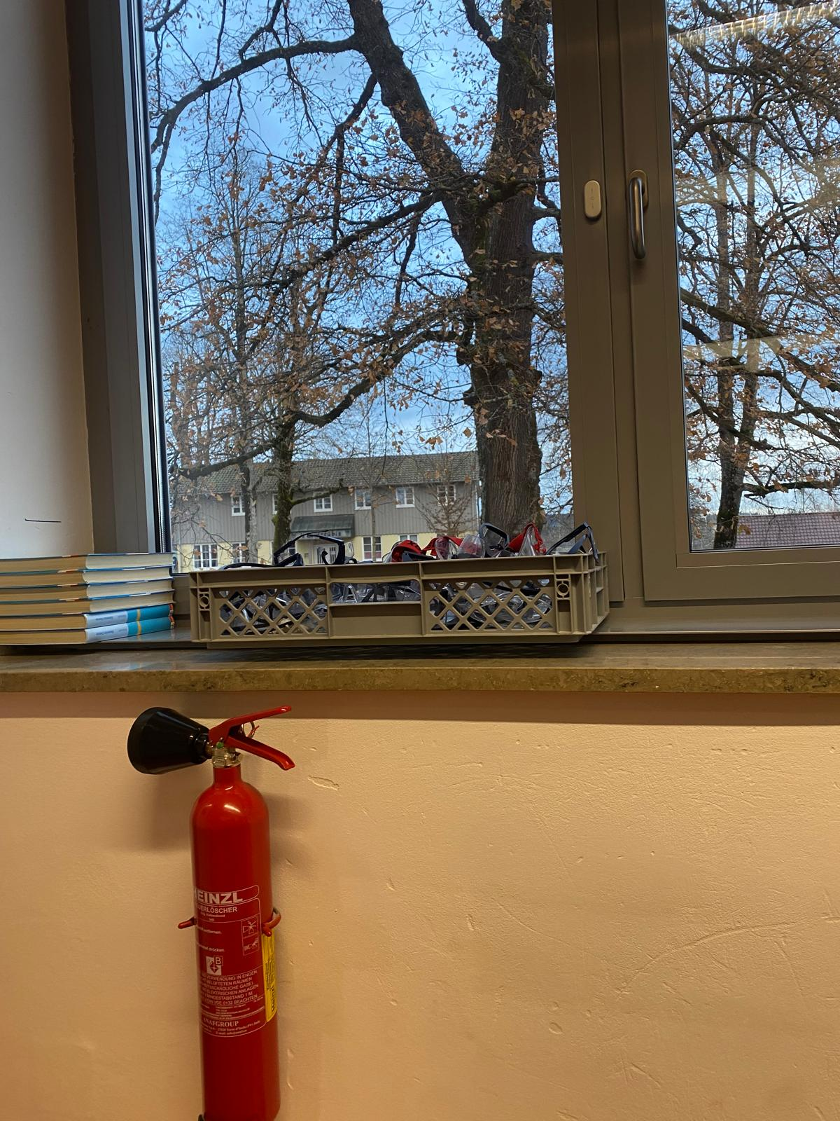
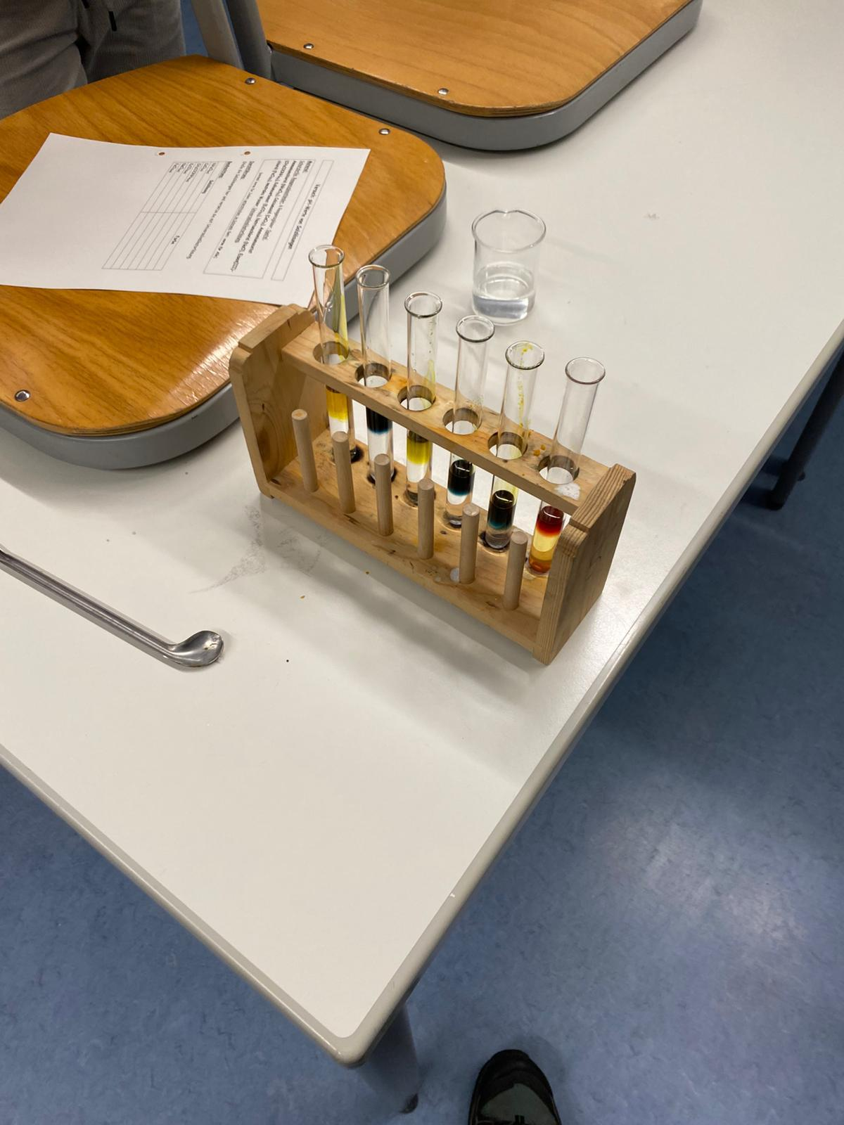
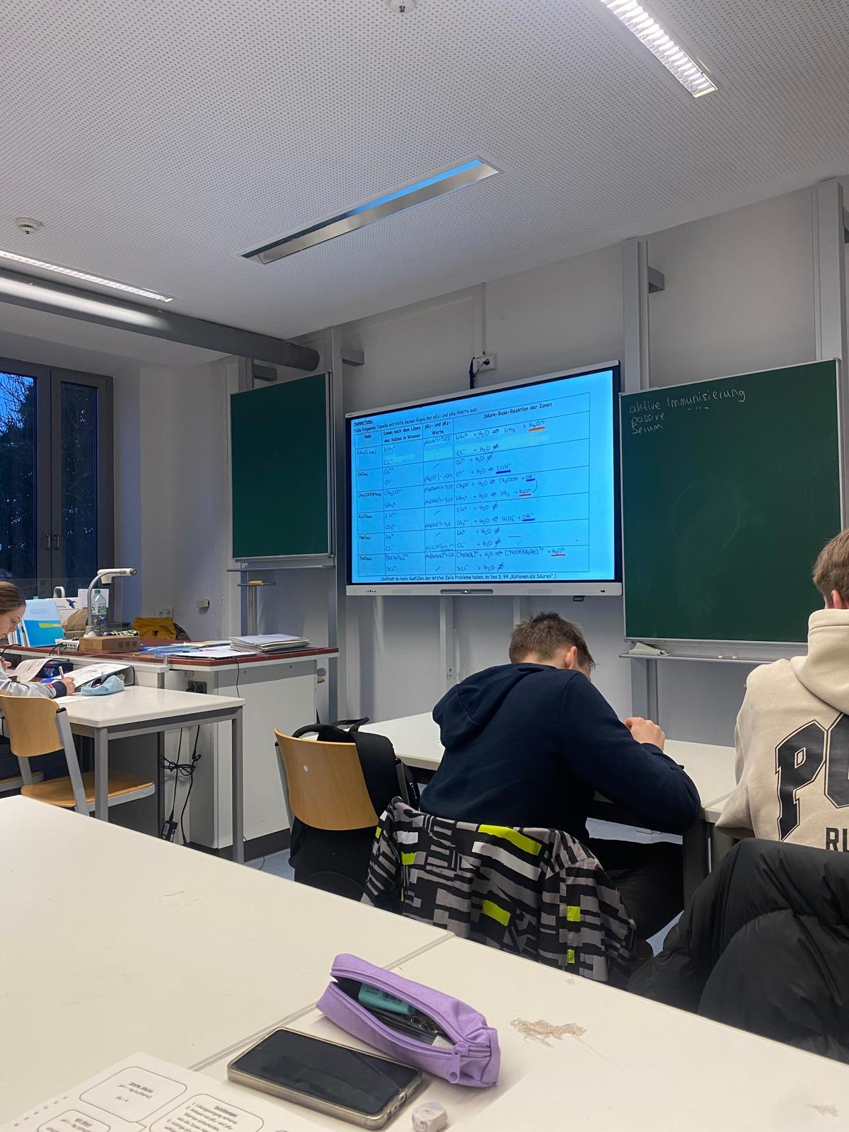
THE CHEMISTRY CLASS

Slide 6
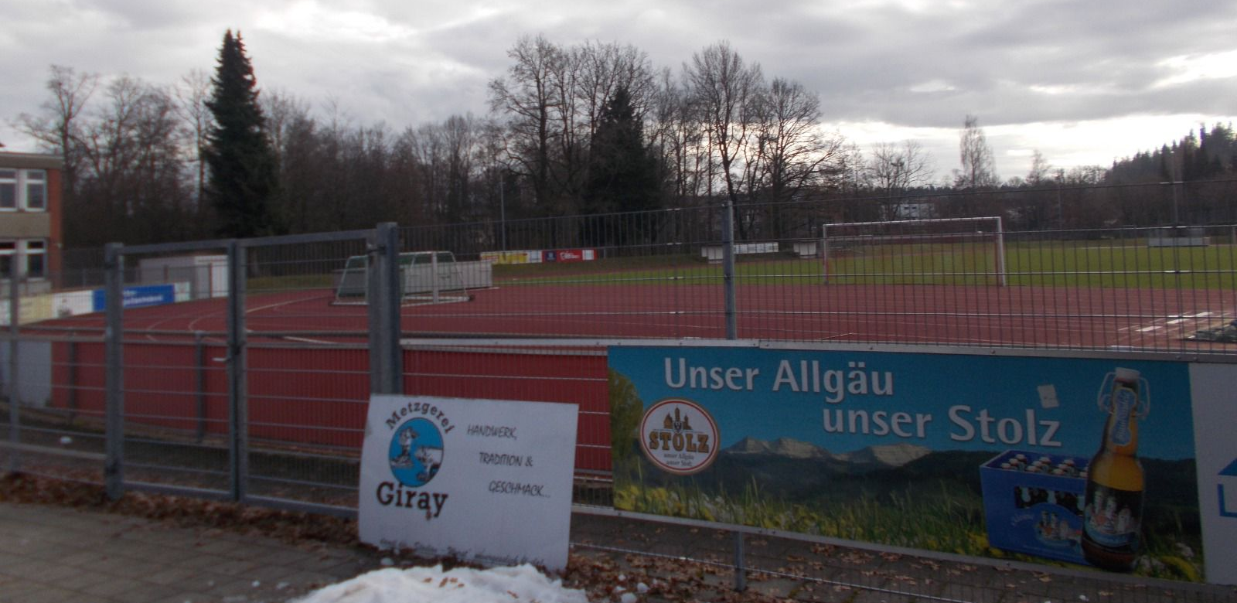
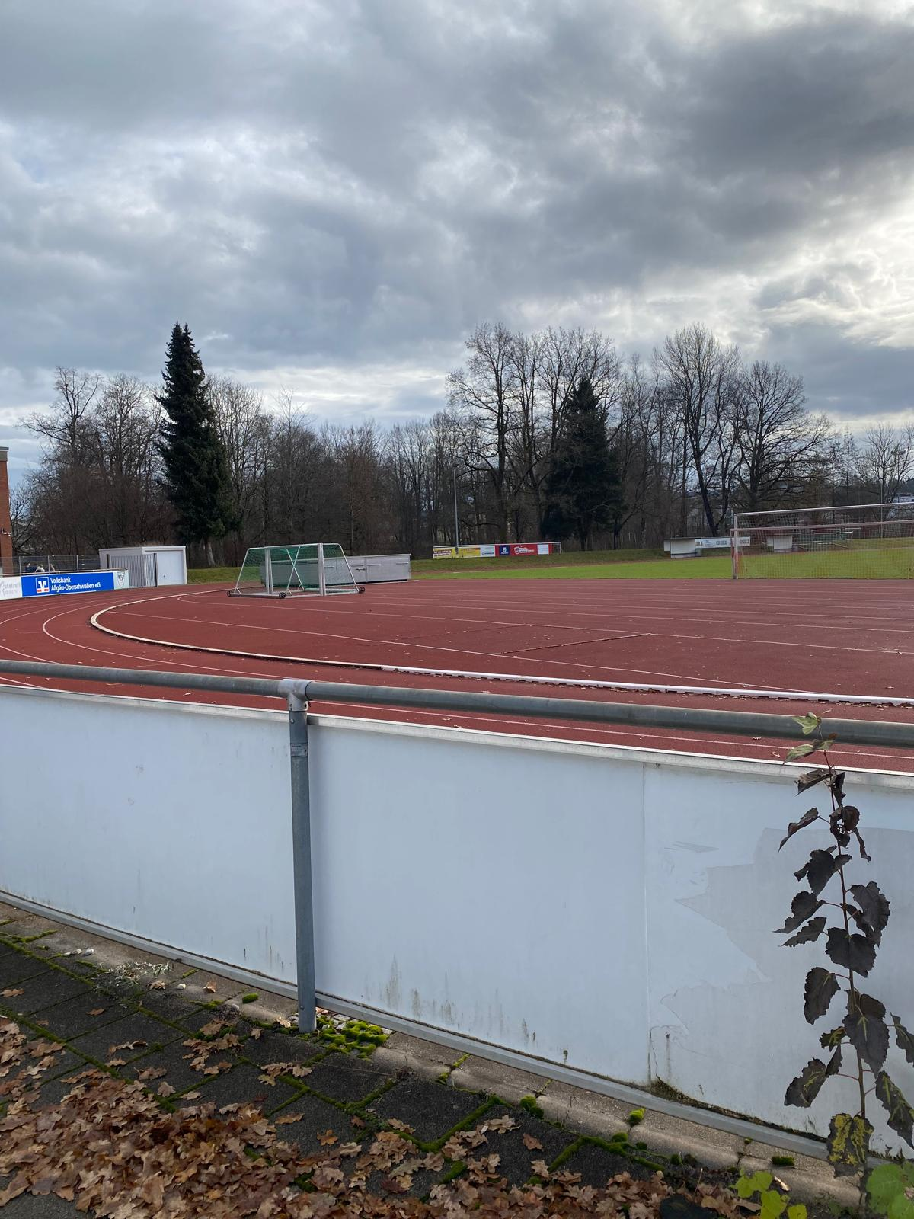
THE OUTSIDE
They also have an athletics field outside the school with the football court inside. They have also like six gyms inside the school with a lot of stuff like a climbing wall and all the things to practise artistic gymnastics.

Slide 7
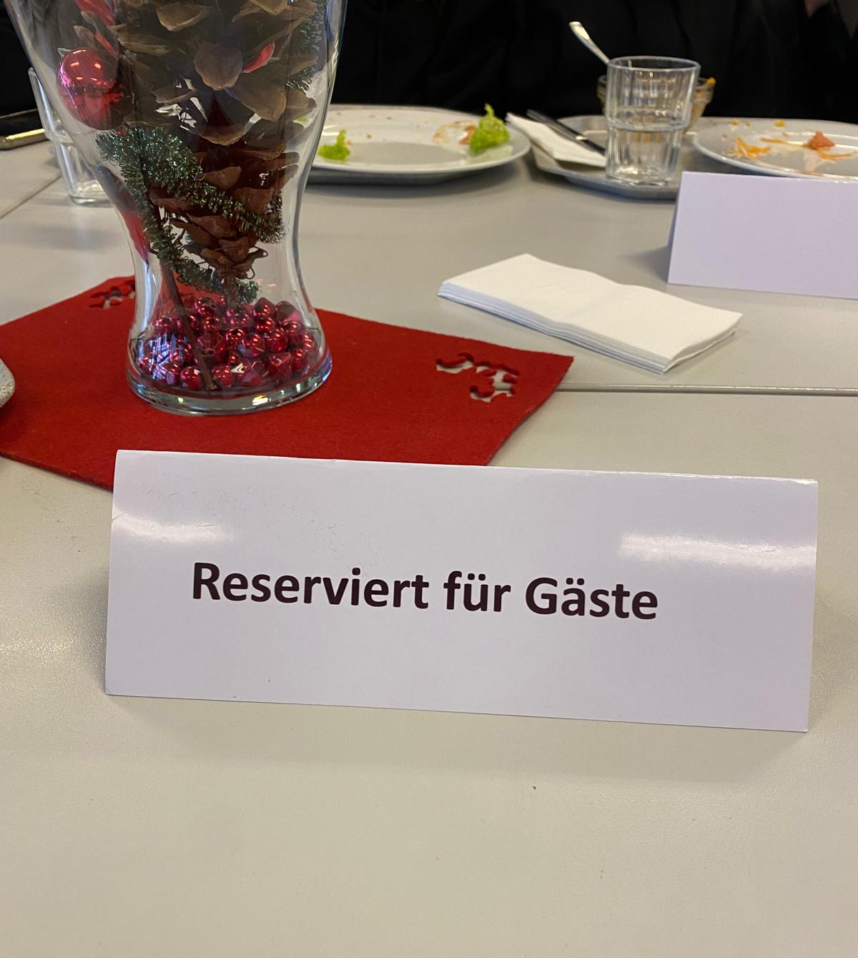
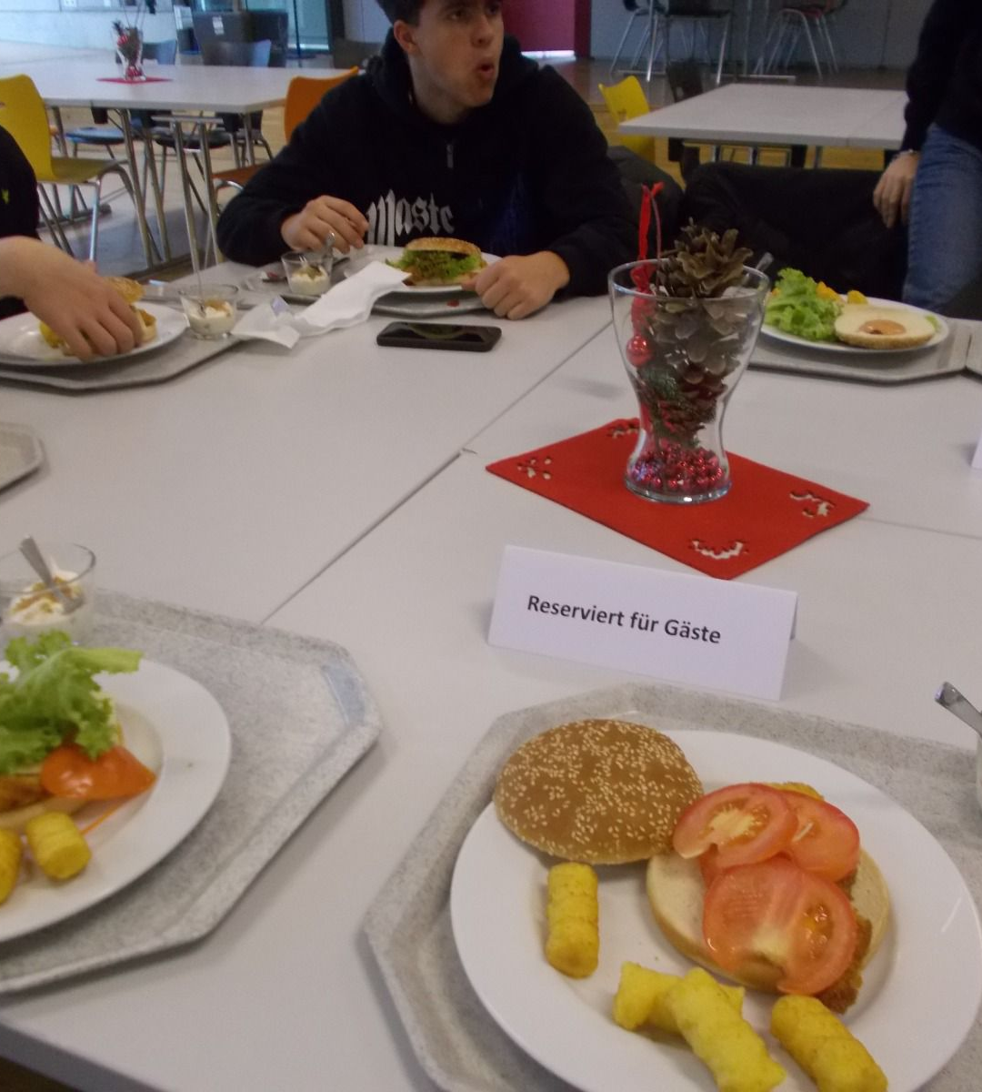


THE CANTEEN AND THE LUNCH
On the second day we were there we had lunch at school and we could decide what to eat from the menu they had. They also reserved a table in the canteen for us italian.

Slide 8
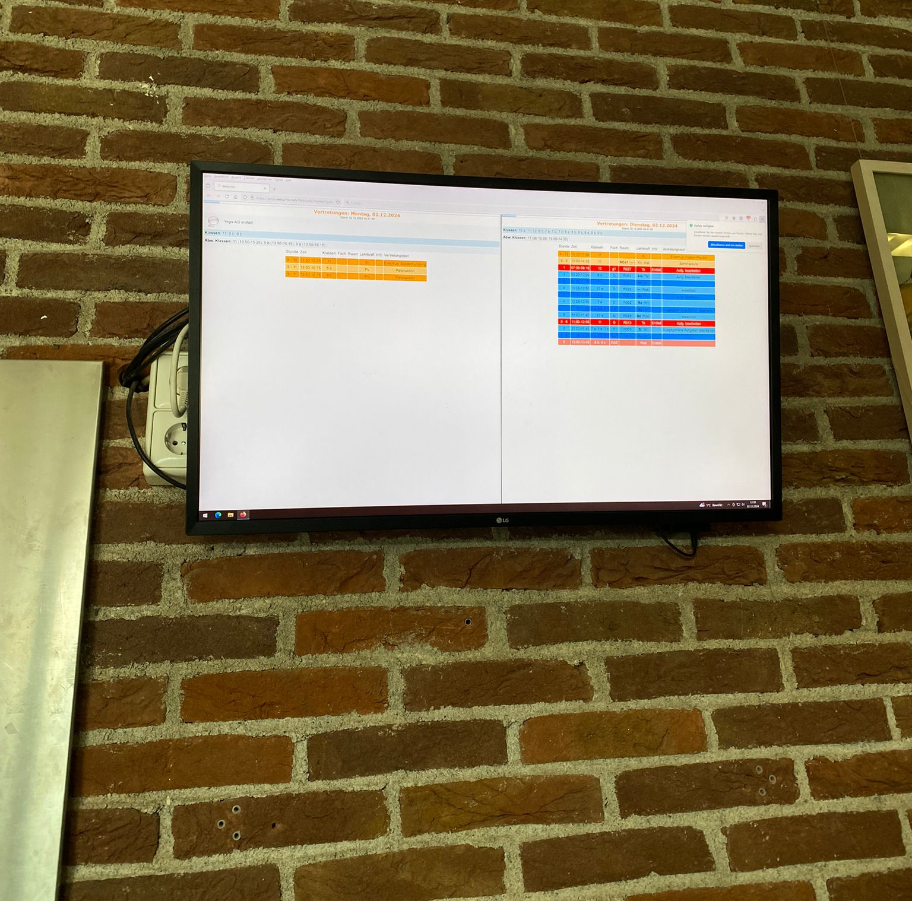
The last difference at their school compared to ours is that the students there can see which class they have to go to or if they are missing a teacher through a television that is in the corridors

Slide 9
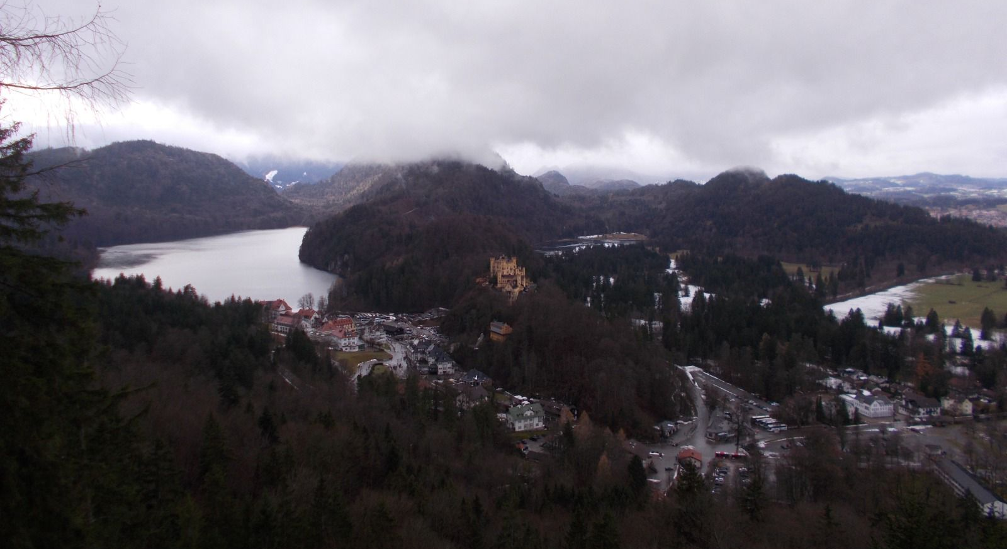
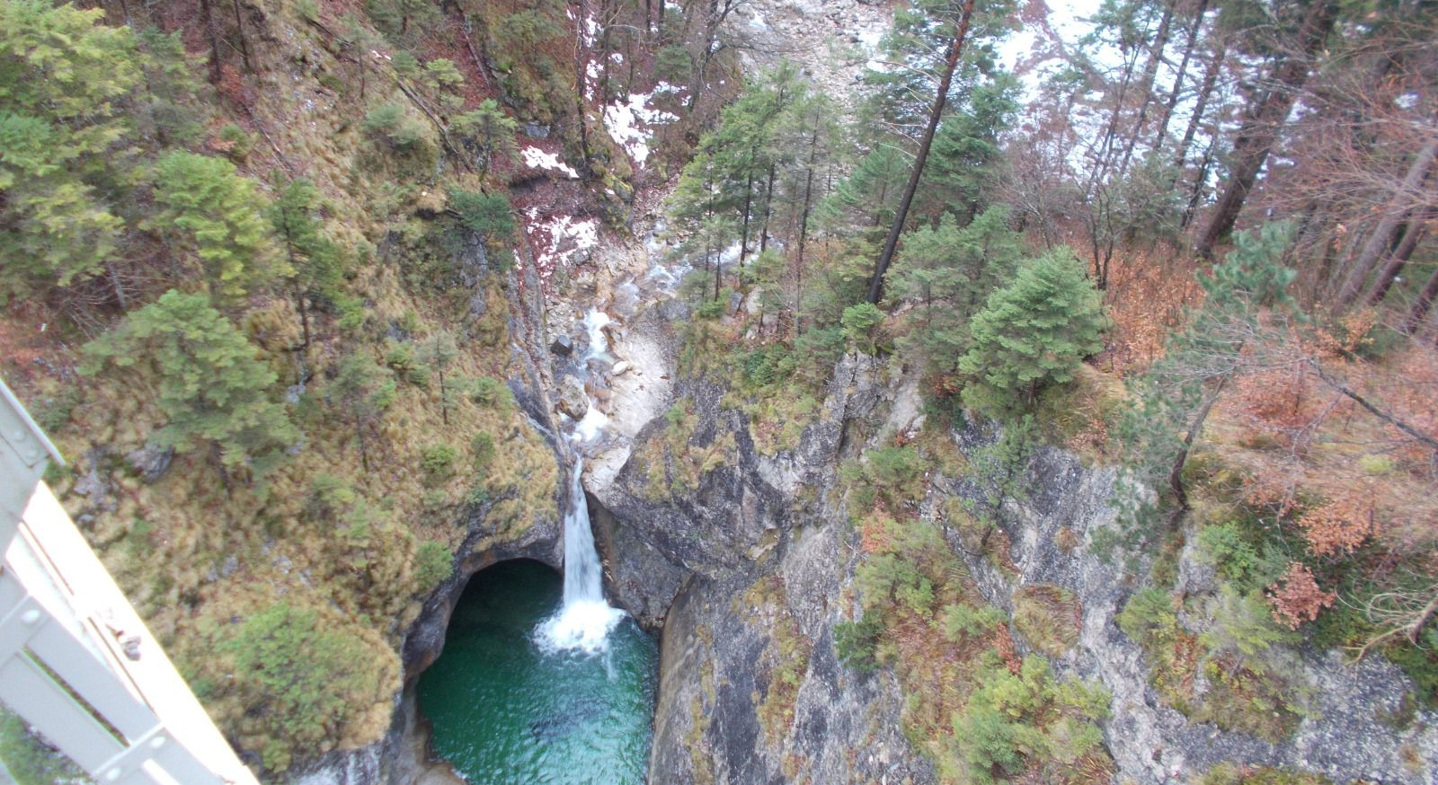
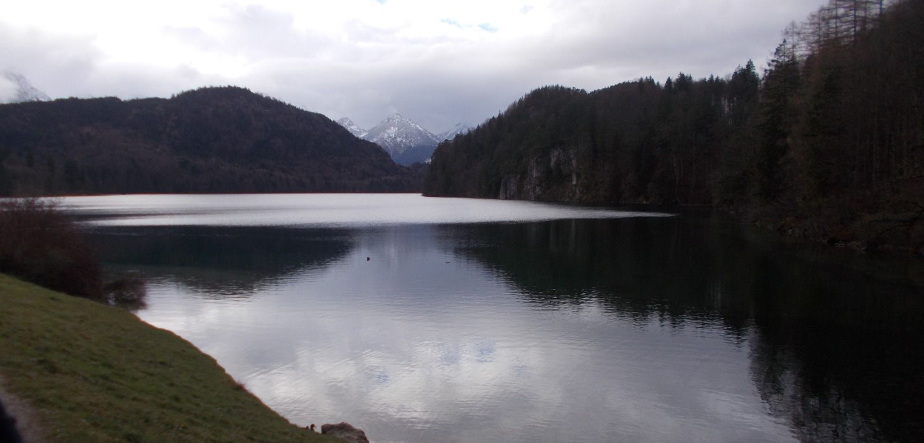
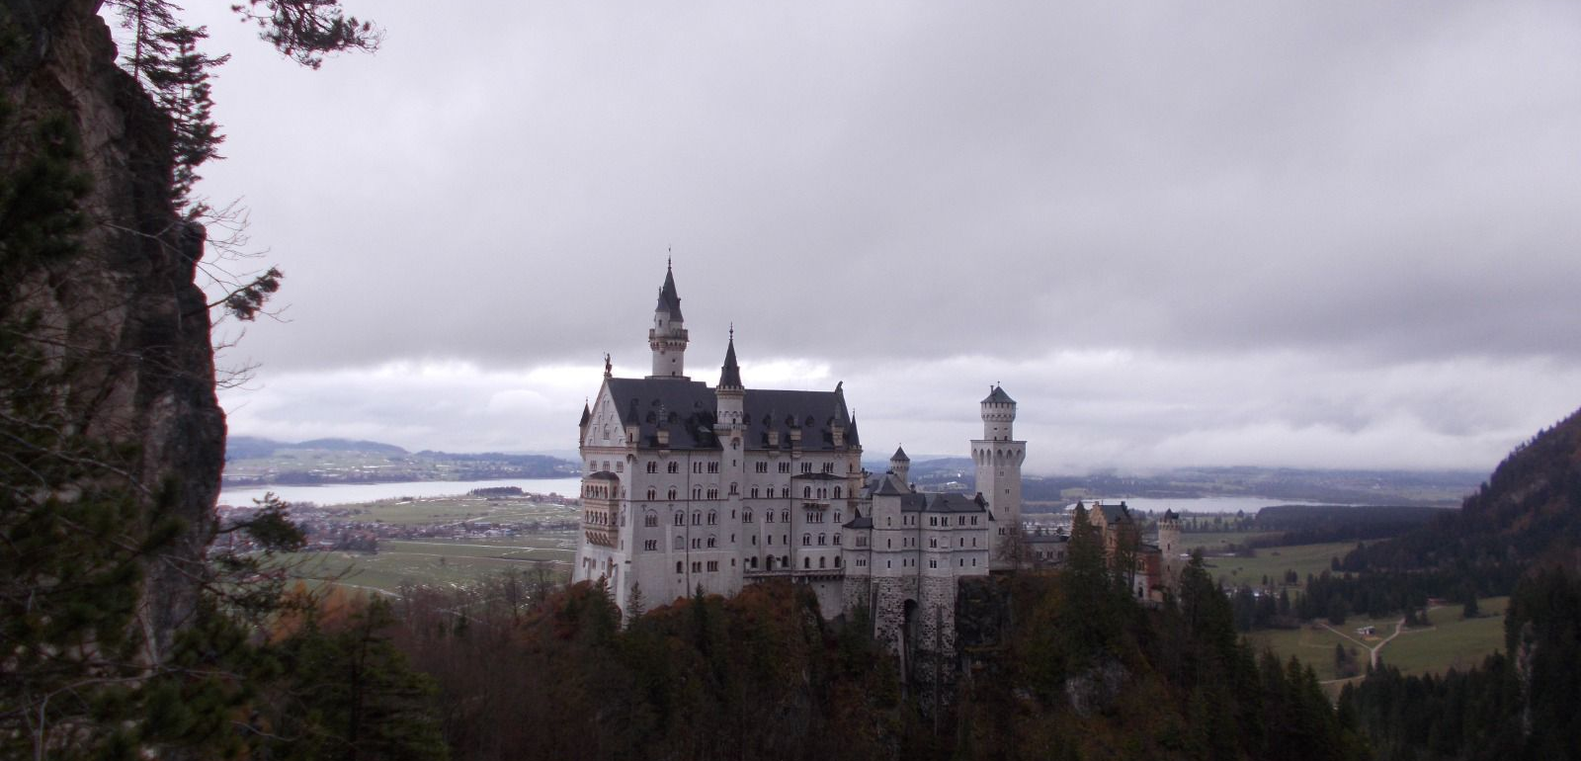
One of the best things we've seen are the beautiful landscapes

Slide 10
